Slide 1
Underwater Continuum Manipulator V2 Assembly Guide
Autonomous Robotic Manipulator Lab
Stevens Institute of Technology

Slide 2
Arm Assembly

Slide 3
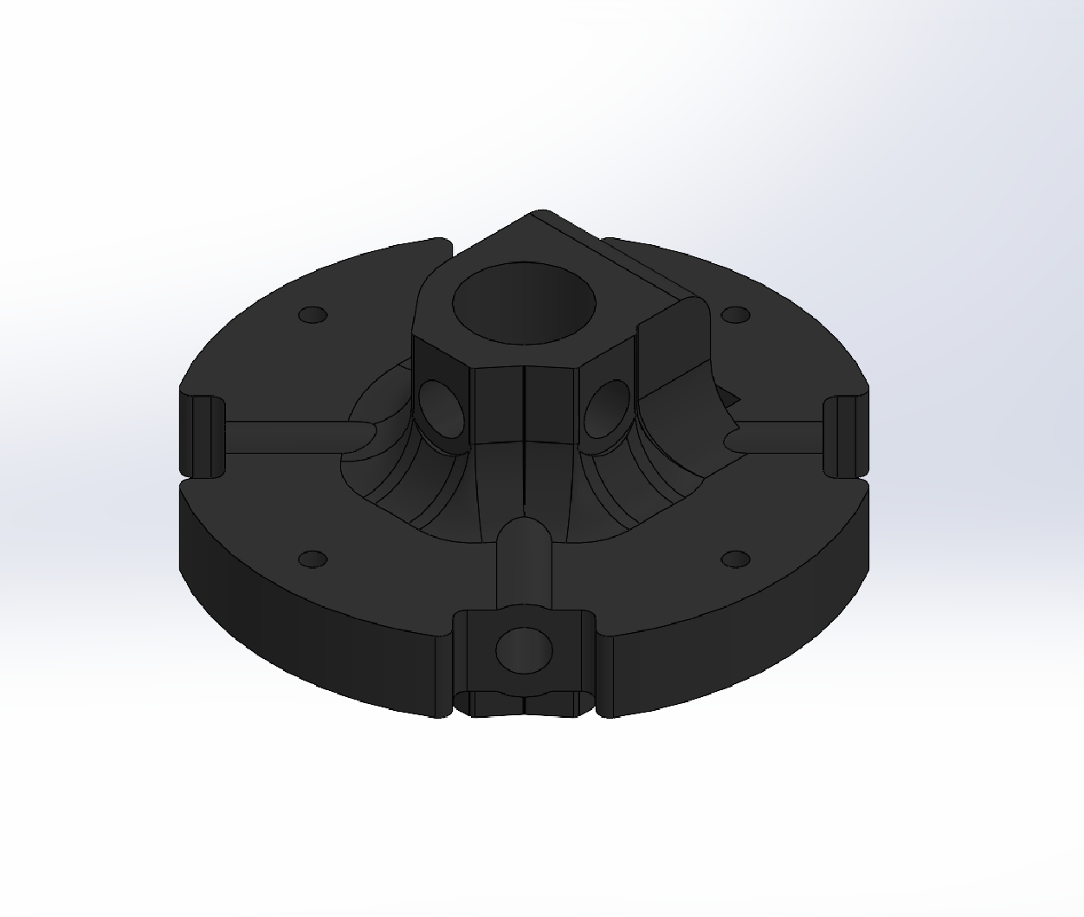
Link Assembly
Start with the arm link

Slide 4
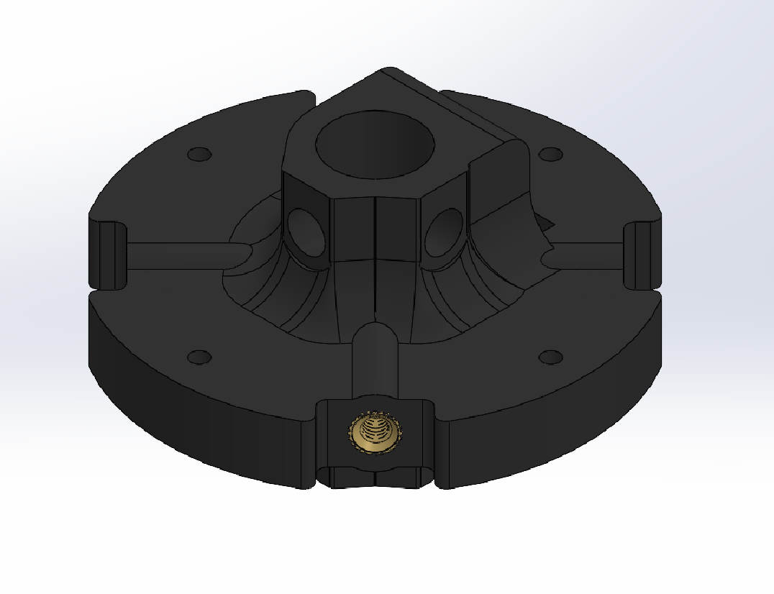
Link Assembly
Insert M3 x 5.7mm heat set insert into each side hole
Note: A soldering iron or heat application tool with a similar end can be used to easily insert the heat set insert

Slide 5
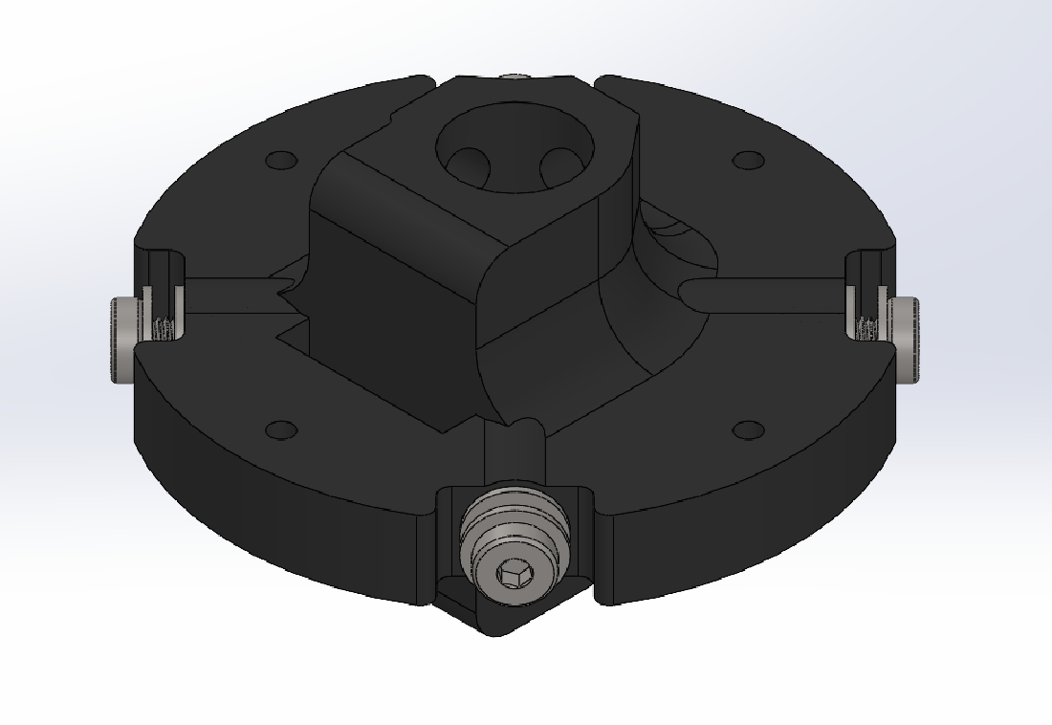
Link Assembly
Screw in M3x0.5 10mm size machine screws with two M3 size washers into each heat set insert

Slide 6
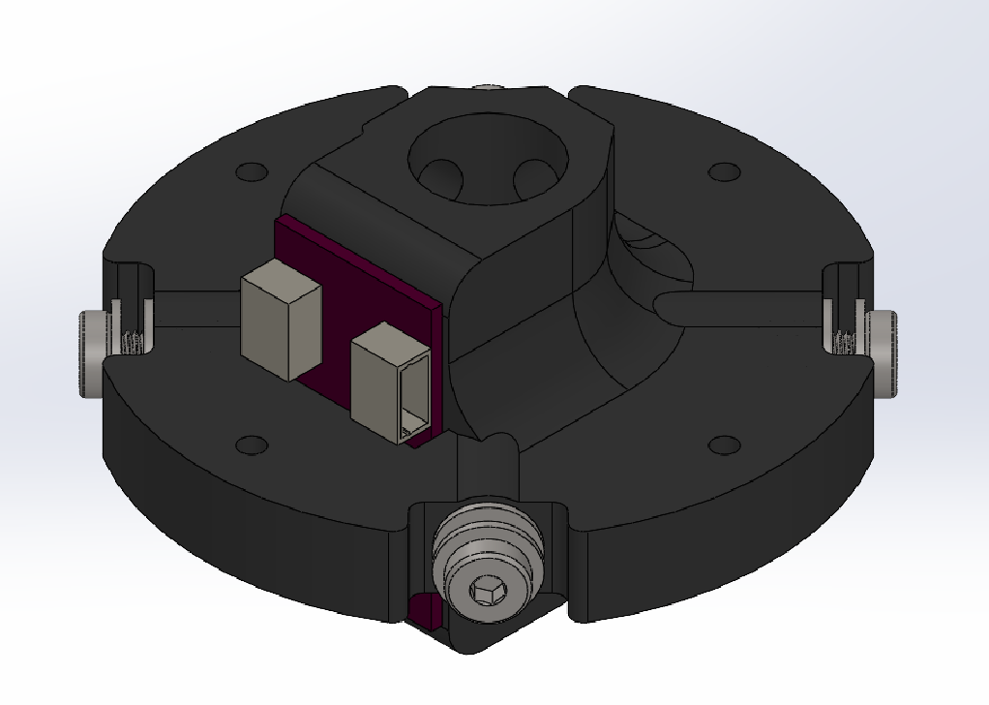
Link Assembly
Attach an IMU board to the link via hot glue in the slot on the inside of the link

Slide 7
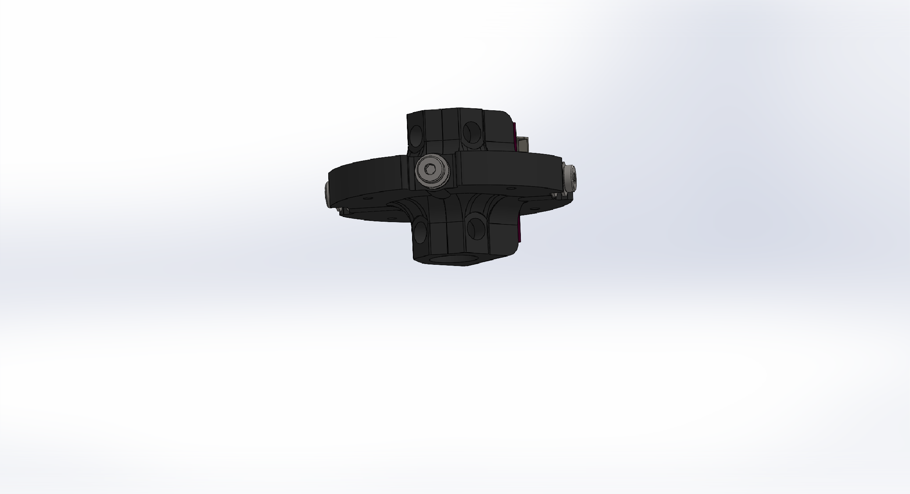
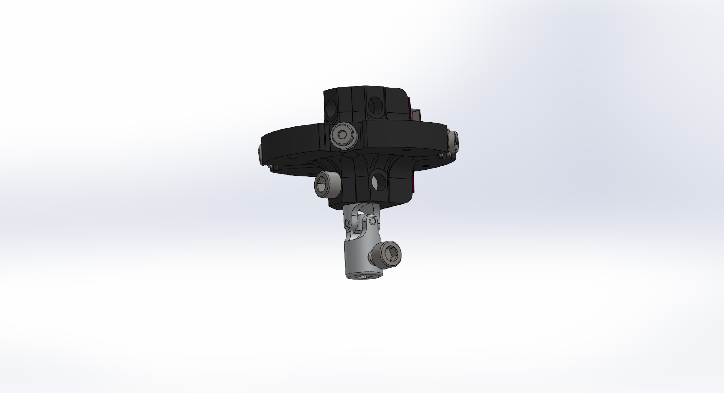
Link Assembly
On the bottom of each link, screw in a VEX universal joint to one of the two holes
Note: By aligning each of the two holes on the VEX joint to be in line with the holes will lead to easier assembly of the full arm

Slide 8
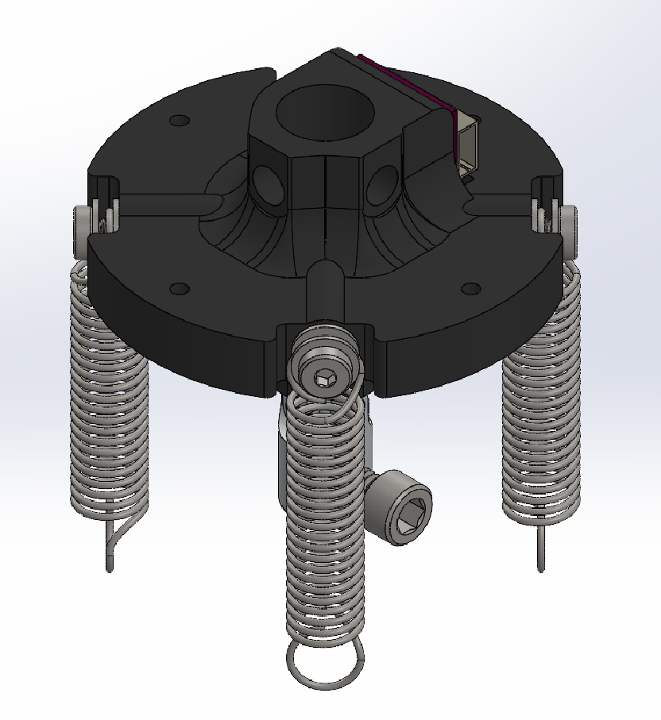
Link Assembly
On each screw attach a spring and screw in the screw to clamp the end of the spring to the link

Slide 9
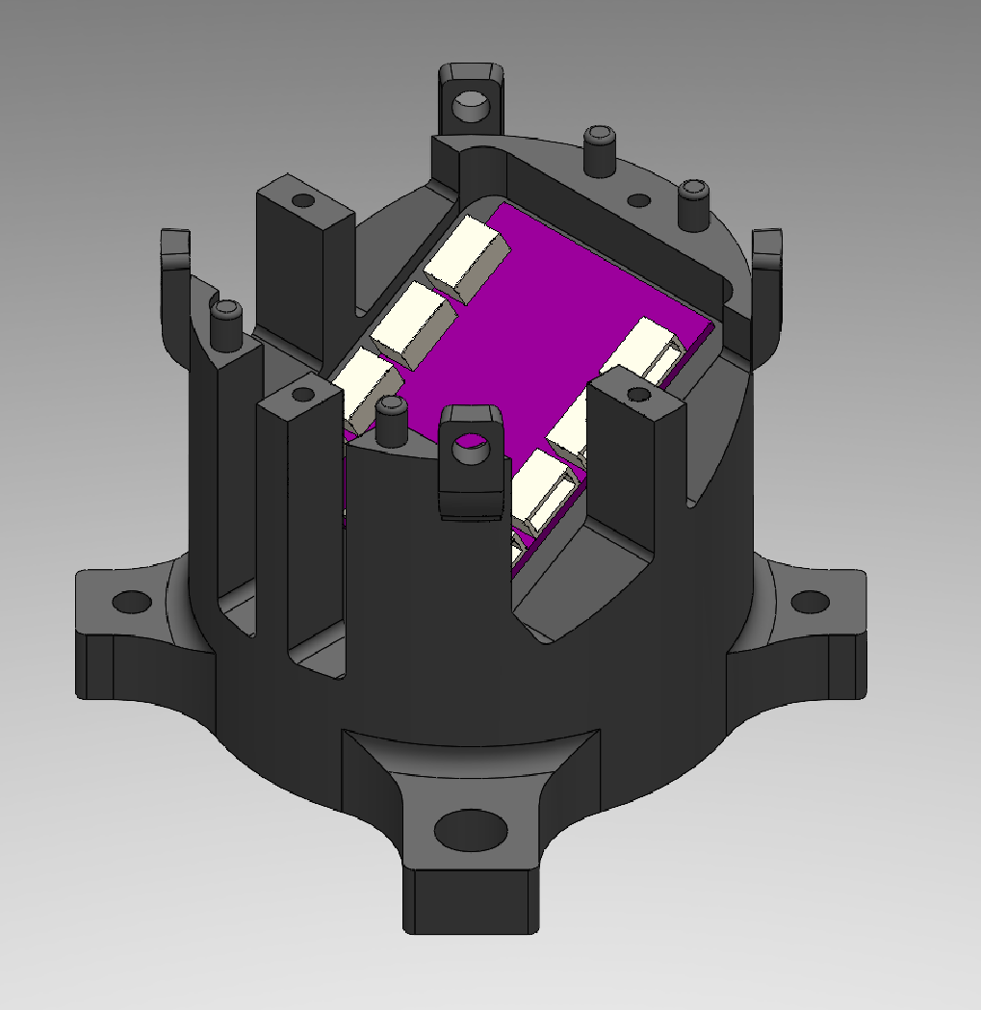
Arm Assembly
On the lower half of the base of the arm, insert the IMU mux

Slide 10
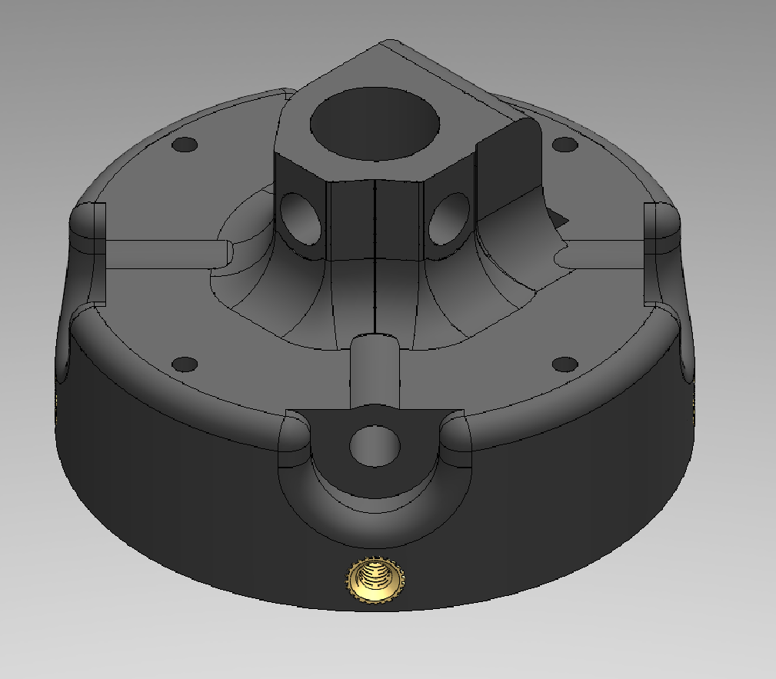
Arm Assembly
On the upper half of the arm base, insert M3 x 5.7mm heat set inserts into each of the lowest side holes

Slide 11
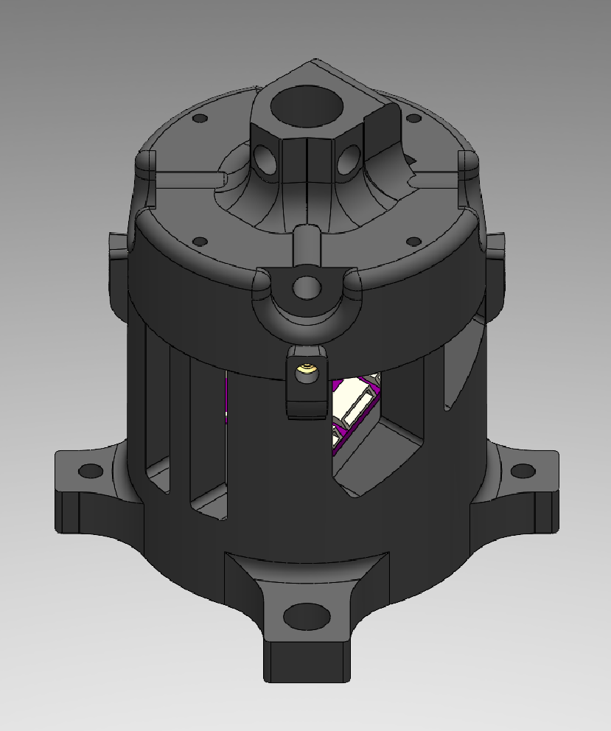
Arm Assembly
Set the upper half of arm base onto the lower half with the heat set inserts lined up with the extensions on the base

Slide 12
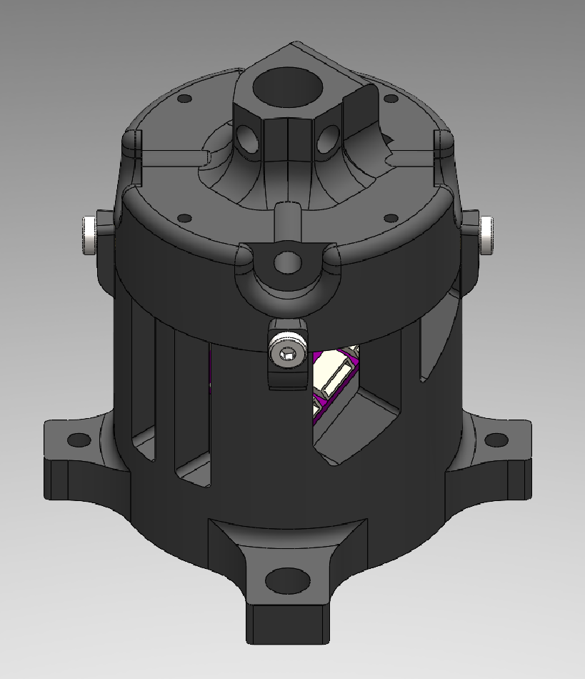
Arm Assembly
Insert an M3x0.5 10mm screw into each of the heat set inserts through the attachment holes of the upper half of base

Slide 13
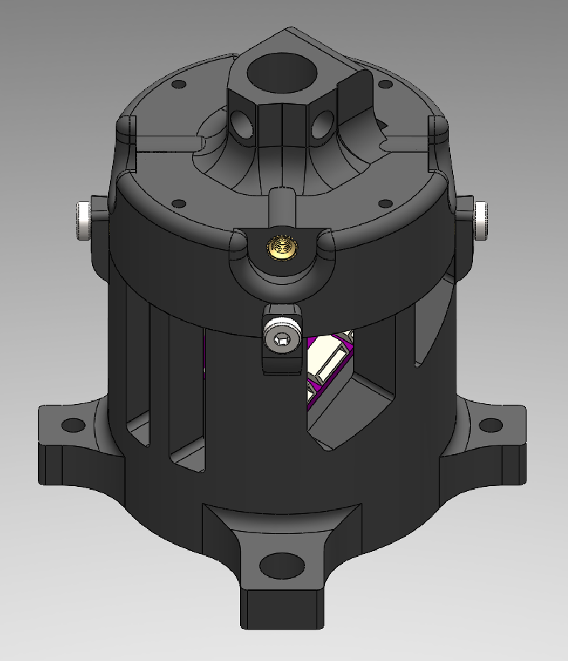
Arm Assembly
Insert M3 x 5.7mm heat set insert into each of the upper side holes on the upper half of the base

Slide 14

Arm Assembly
Insert M3x0.5 10mm screws with two washers into heat set inserts on the upper half of the base

Slide 15
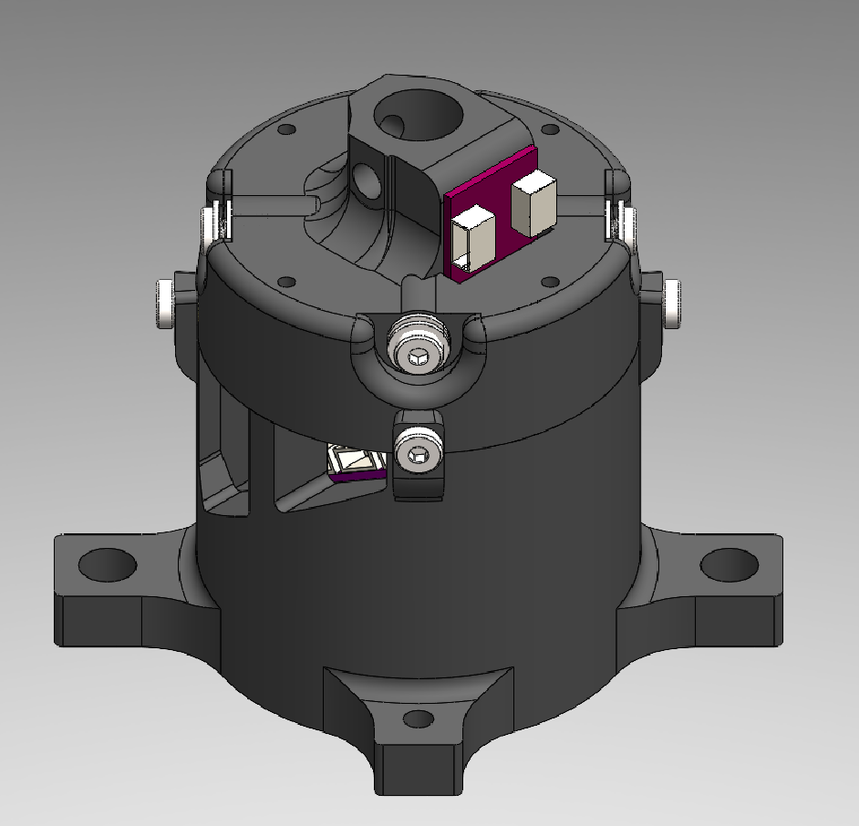
Arm Assembly
Attach IMU to the upper half of the base in slot on the inside of the base

Slide 16
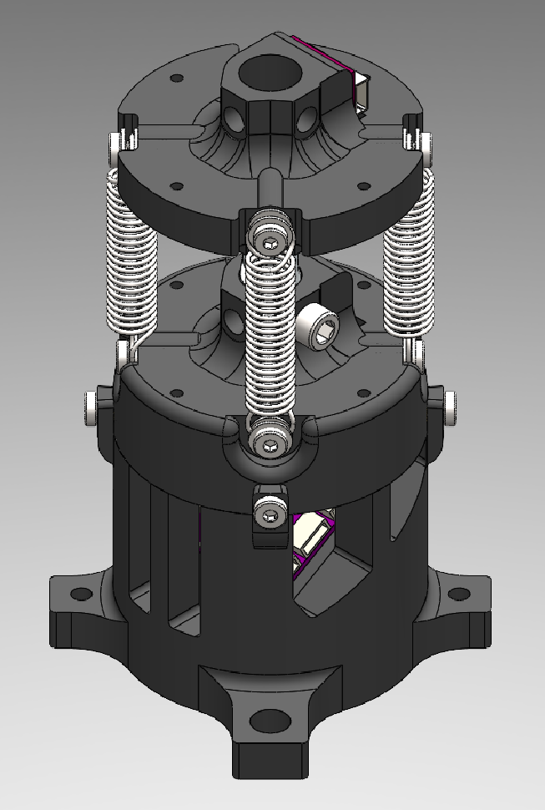
Arm Assembly
Screw on the other end of the VEX universal joint of a completed link to the arm base
Attach the bottom of the springs to the screws and washers of the base

Slide 17
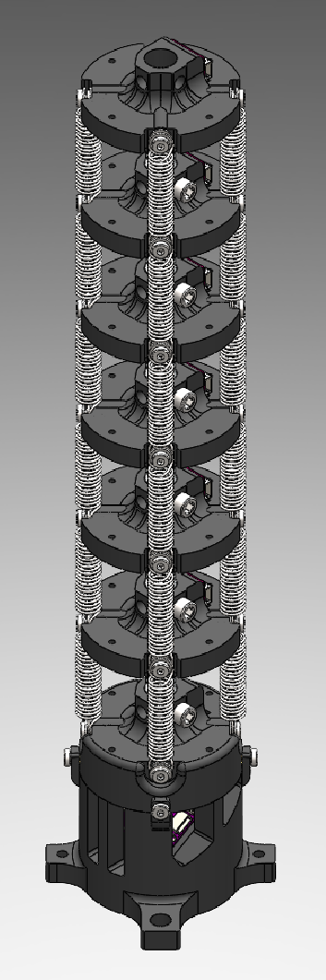
Arm Assembly
In the same way as the first link, add each link to the arm
Attach the springs of each link to the screws of the below link, clamping them down with the washers in same fashion as before

Slide 18
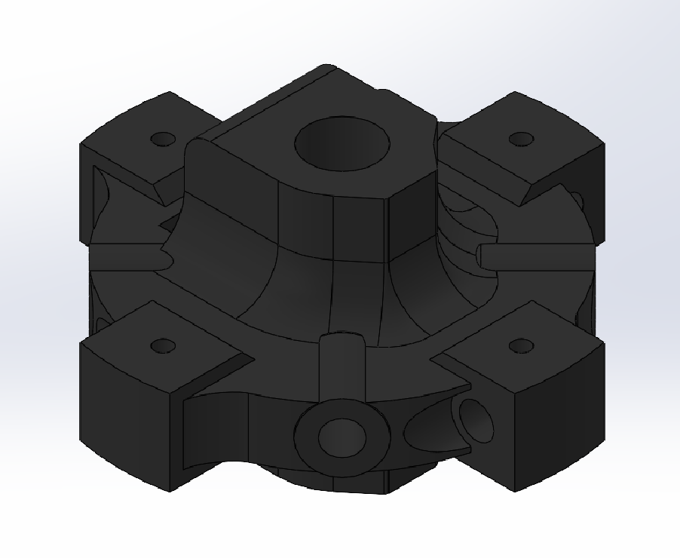
End Link Assembly
In the same fashion as a standard arm link, start with the end link

Slide 19

End Link Assembly
First, inert M3 x 5.7mm heat set inserts into each of the holes on the side of the main circle of the link

Slide 20
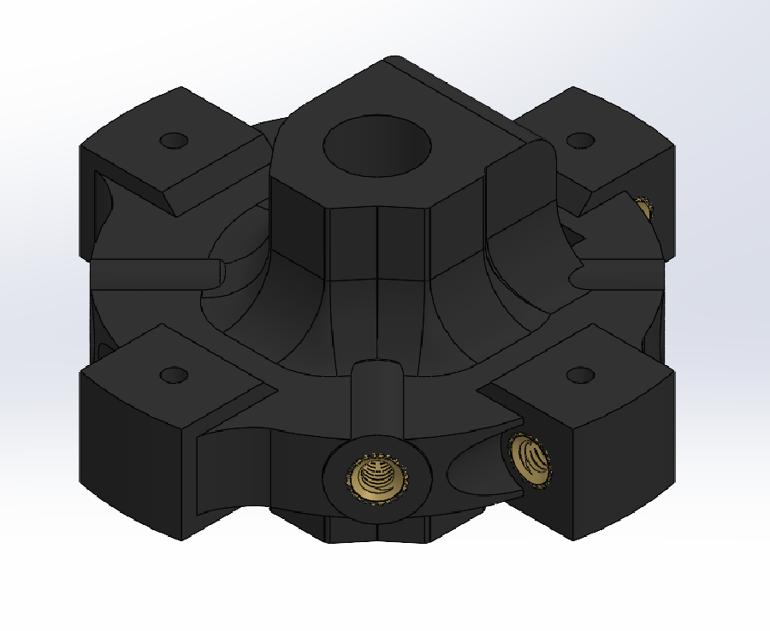
End Link Assembly
On each of the protrusions of the link, insert a M3 x 4.3mm heat set insert into the hole on the side.
Note: Inserting a nitinol rod into the small perpendicular hole before inserting the heat set insert helps prevent it from being pushed too far into the hole

Slide 21
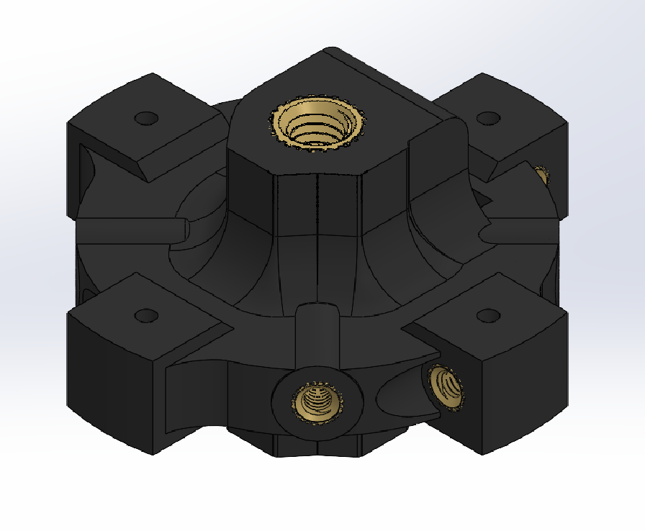
End Link Assembly
On the top end of the end link (the side of the link without screw holes for the VEX universal joint), insert a M6 x 7.9mm heat set insert

Slide 22
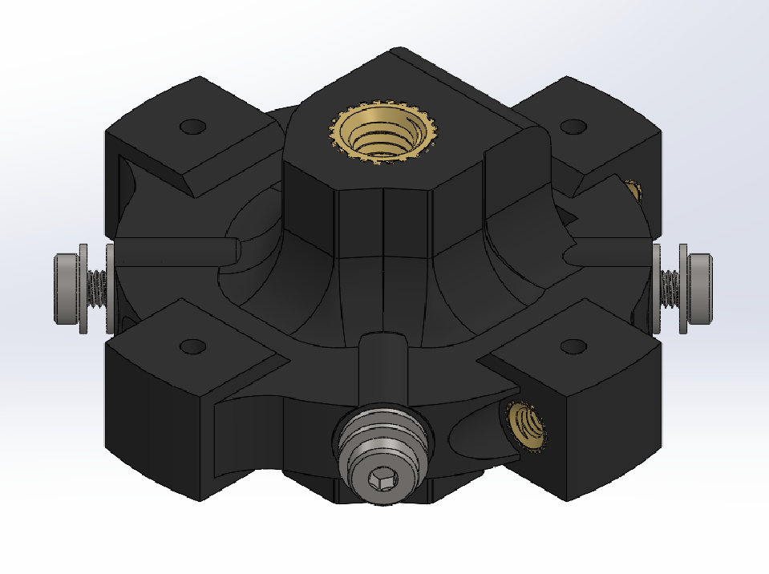
End Link Assembly
In each of the side heat set inserts that are on the main circle of the link, insert a M3x0.5 10mm screw with two M3 washers

Slide 23
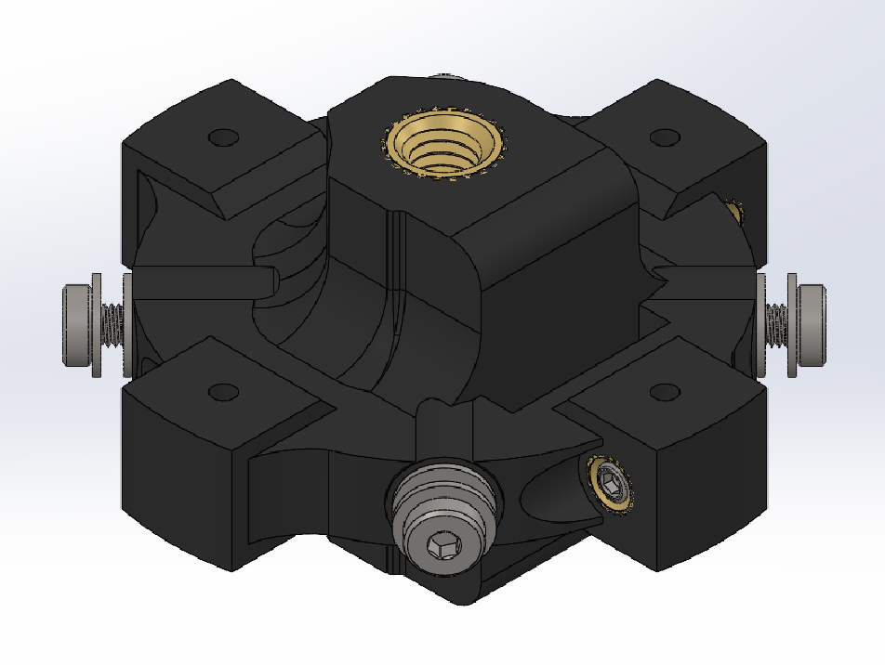
End Link Assembly
In each of the heat set inserts on the protrusions, insert a M3x0.5 4mm set screw for use of locking the nitinol rods once inserted

Slide 24
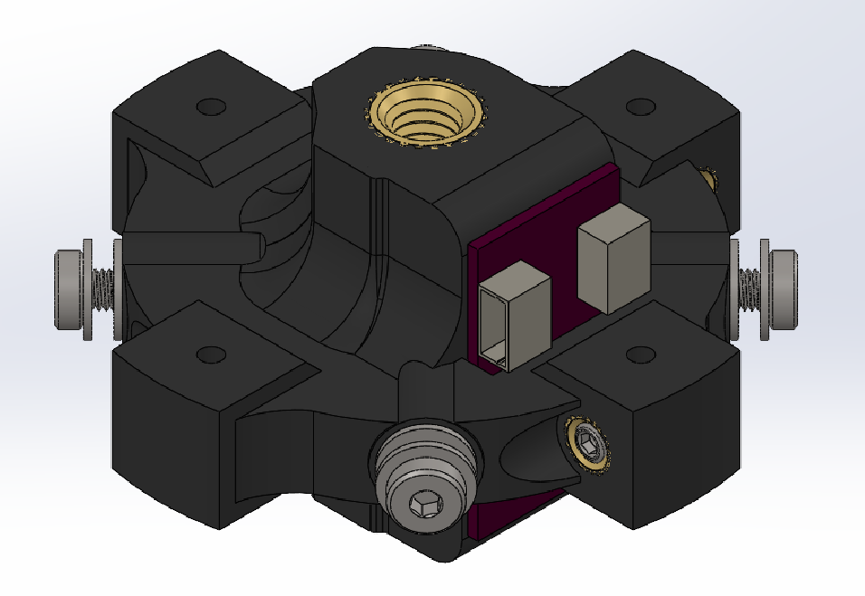
End Link Assembly
Attach IMU board to the end link the inner slot of the link via hot glue

Slide 25
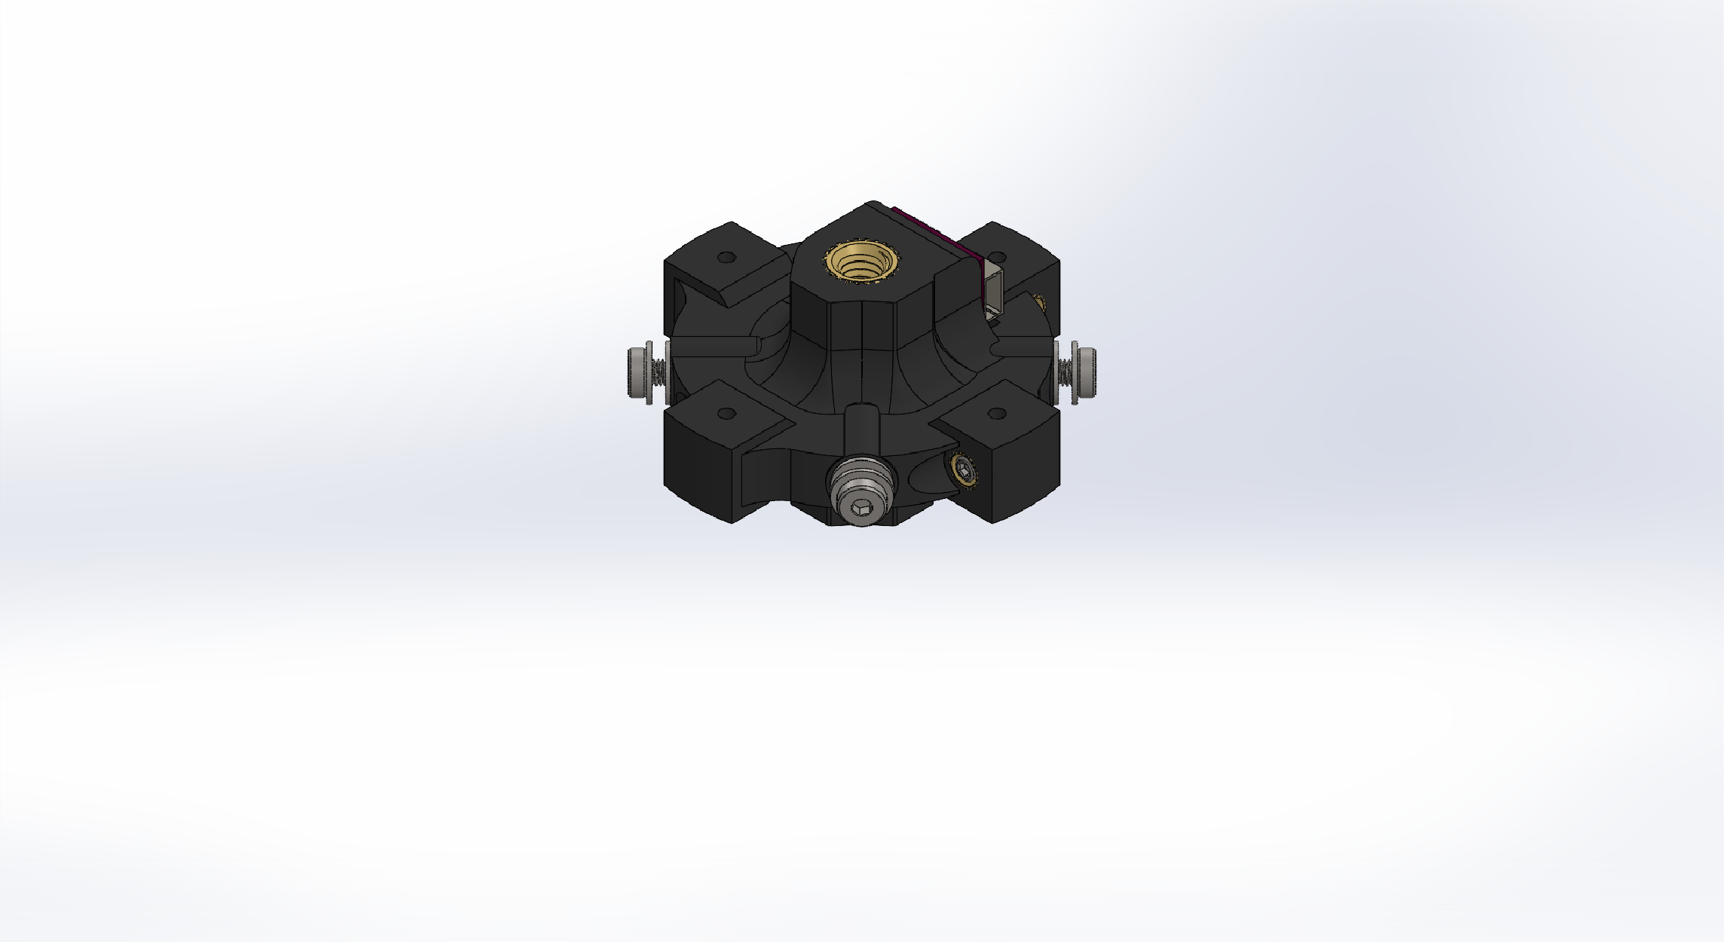
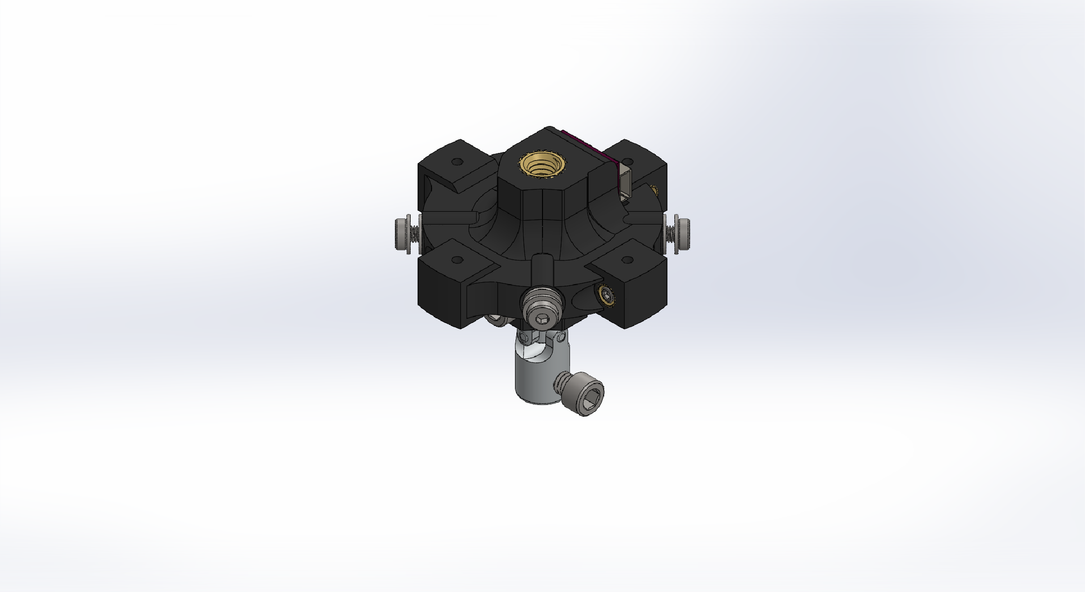
End Link Assembly
Attach VEX universal joint by inserting joint into the large hole on the lower half of the link and inserting the screw into the joint through the side holes on the connection

Slide 26
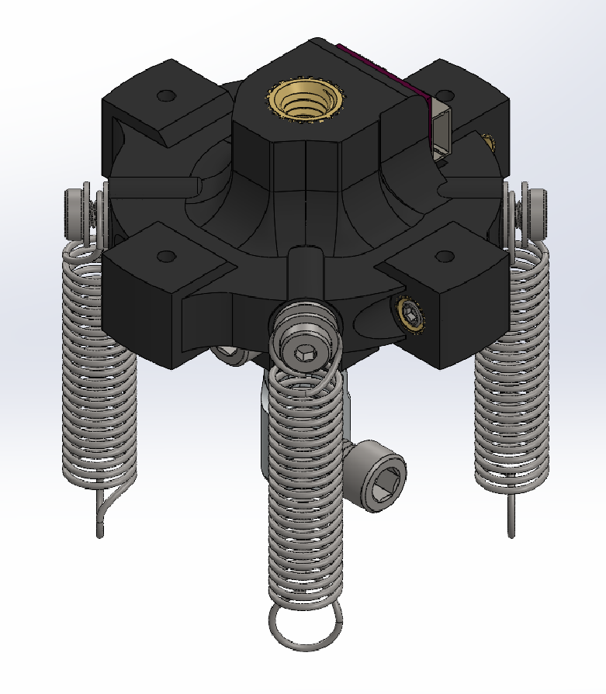
End Link Assembly
On each screw attach a spring and screw in the screw to clamp the end of the spring to the link

Slide 27
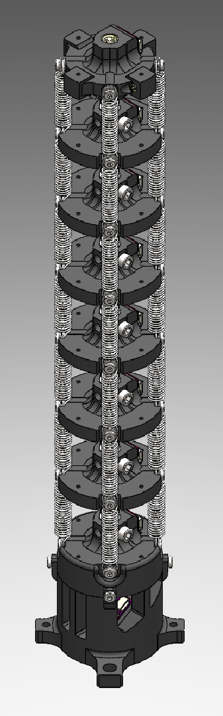
Arm Assembly
Attach the end link to the top of the arm in the same way that the other links were attached

Slide 28
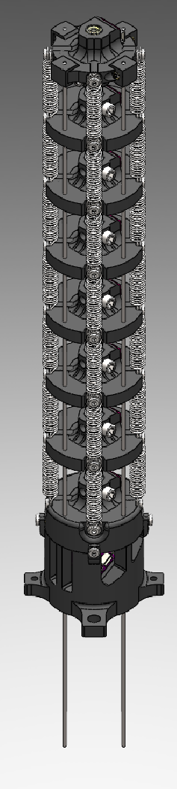
Arm Assembly
Insert nitinol rods through the small holes on the face of each link and fasten the end of the rod in the end link using the set screw in each protrusion

Slide 29
Actuation Unit Assembly

Slide 30
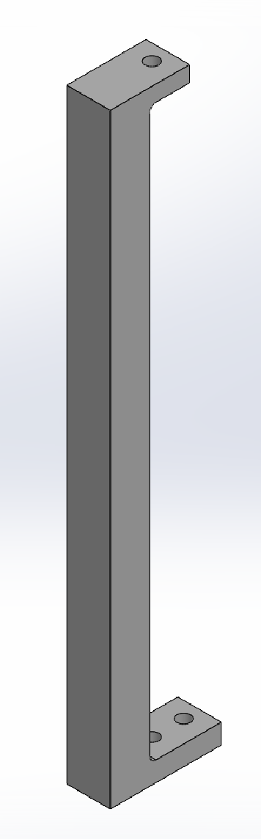
Potentiometer Mount Assembly
Start with the 3D printed potentiometer mount standoff

Slide 31
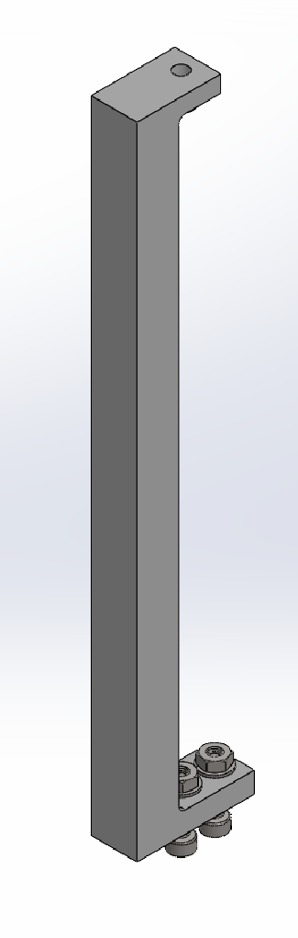
Potentiometer Mount Assembly
When mounting the assembly to the base plate, the screws used will be M3x0.5 12mm screws with M3 nuts and washers

Slide 32
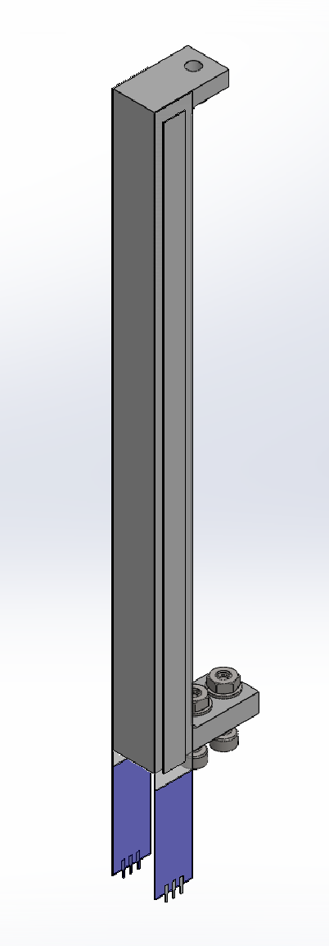
Potentiometer Mount Assembly
On either side of the standoff, stick the linear potentiometers with the wire connections towards the bottom (where the two screws are)

Slide 33
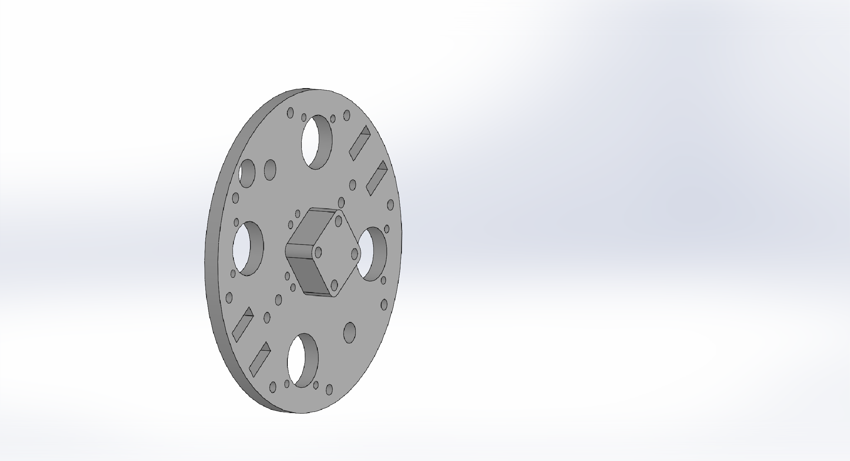
Actuator Assembly
To assemble the actuator, start with the base plate

Slide 34
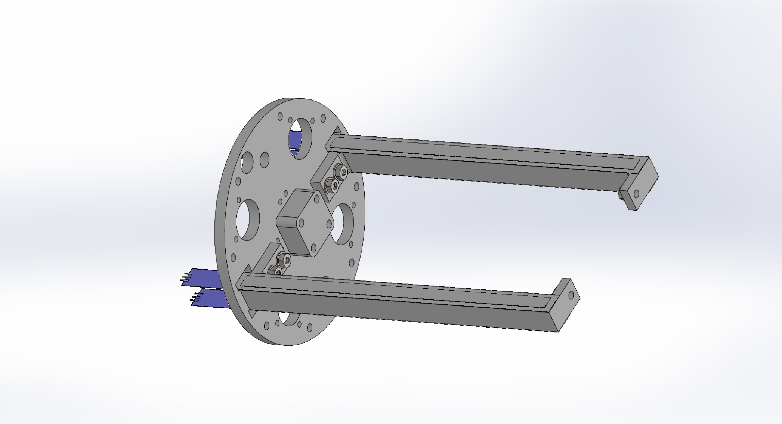
Actuator Assembly
Screw on potentiometer mounts assembled prior to opposite sides of the base with the bottom end of the potentiometer sticking through the slots on either end of the mount base
Thread the screws from the base plate to the mounts with the washers and nuts being on the inside of the mount

Slide 35
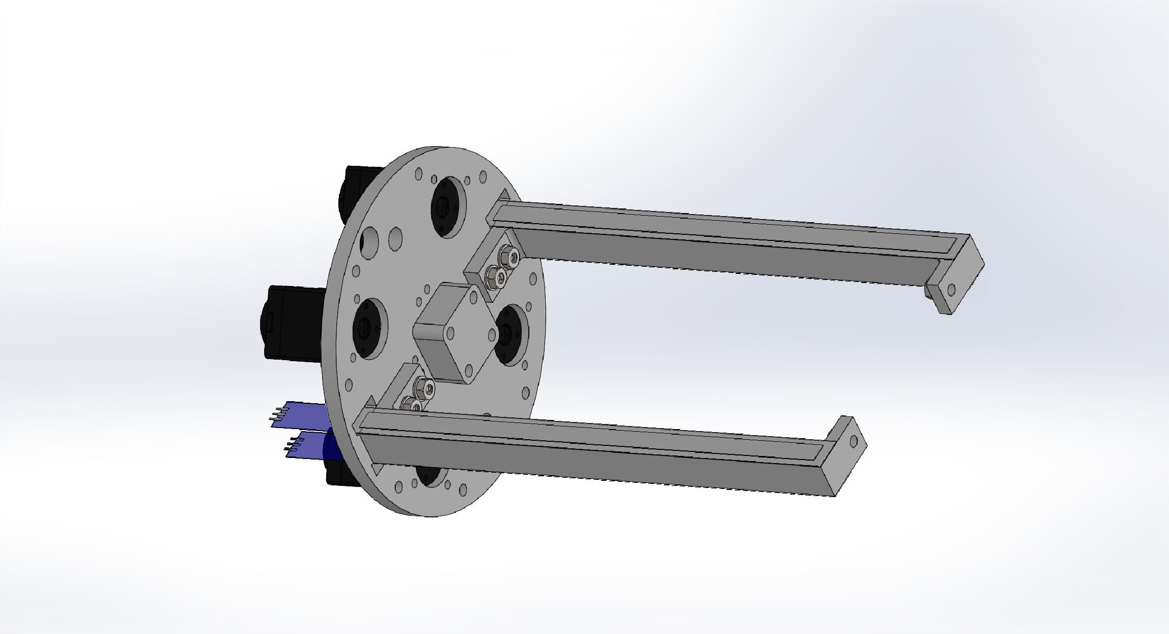
Actuator Assembly
Position Dynamixel XL430-W250-T motors at each large hole on the base with the longer end of the motor pointed towards the center of the base
Connect motors in a chain using 3-wire cable

Slide 36
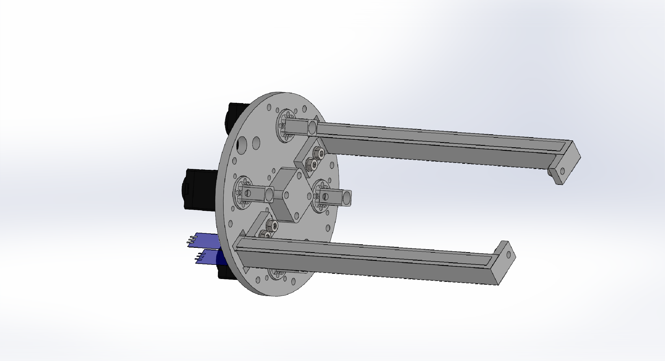
Actuator Assembly
Position each threaded rod mount at in each of the motor holes with the screw holes aligned with the mounting holes on the face of the motors

Slide 37
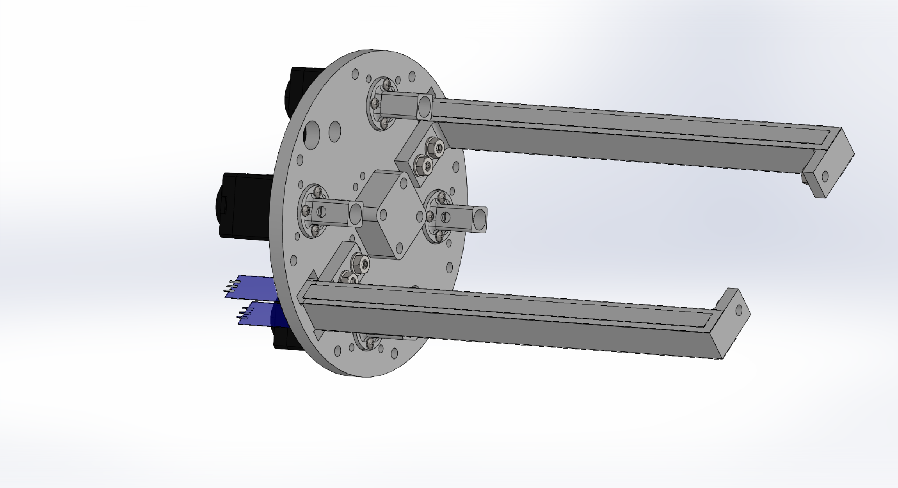
Actuator Assembly
Using 6mm long M2 size screws, attach the threaded rod mounts to the motors

Slide 38
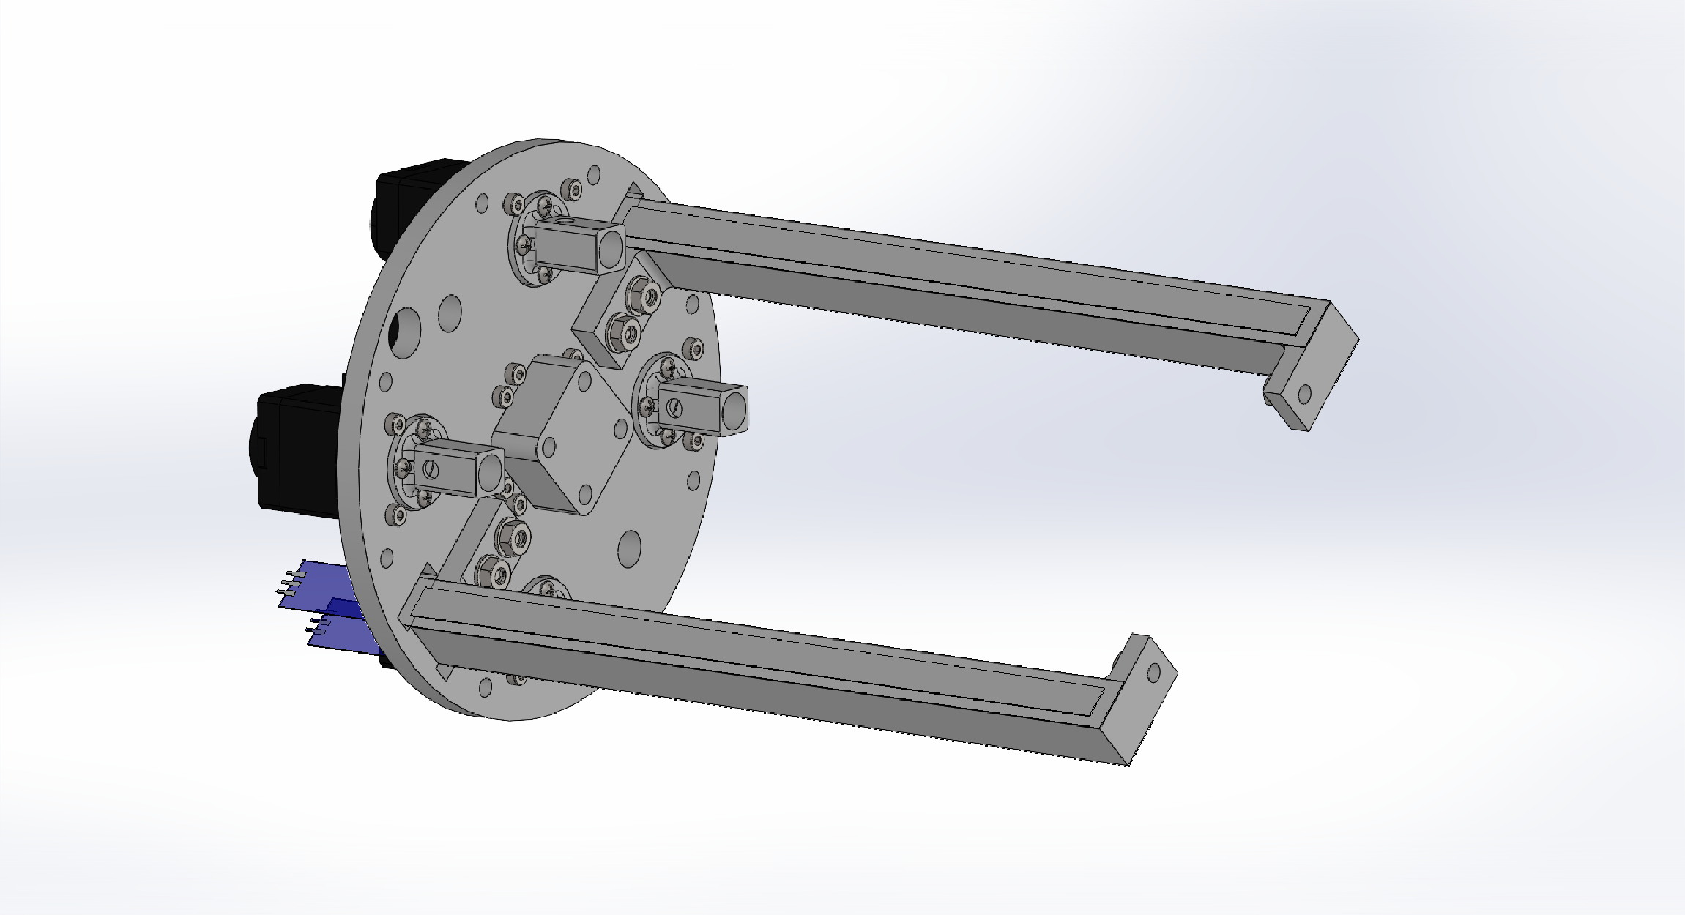
Actuator Assembly
Using 16mm long M2 size screws, attach each of the motors to the base plate

Slide 39
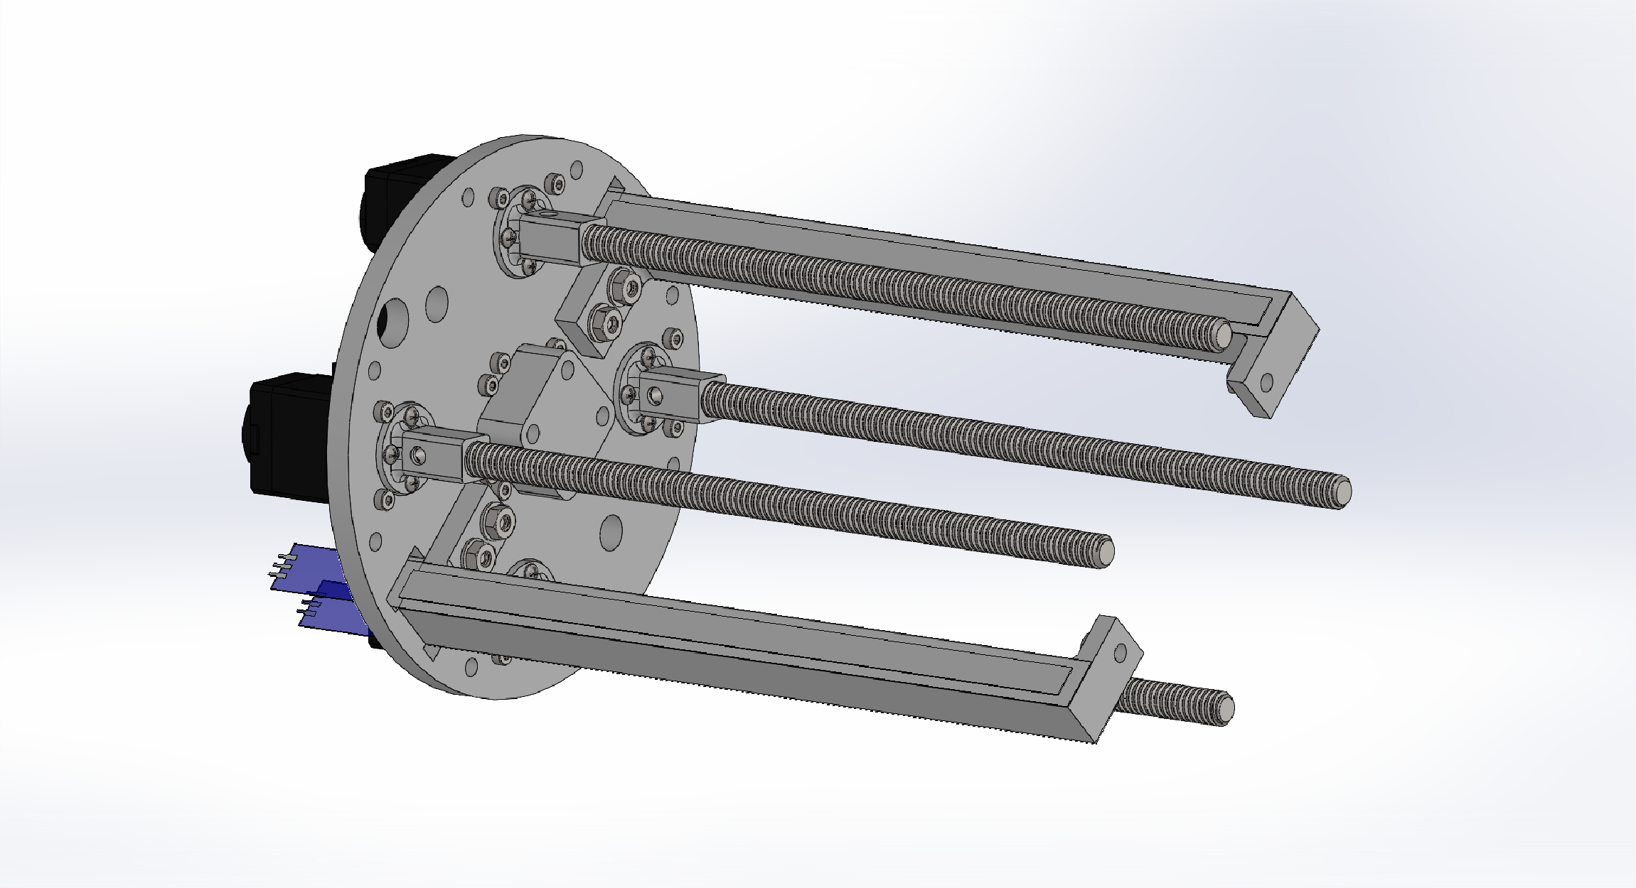
Actuator Assembly
Insert threaded rods into the mounts on the motors, aligning the side hole at the base with the side hole of each mount

Slide 40
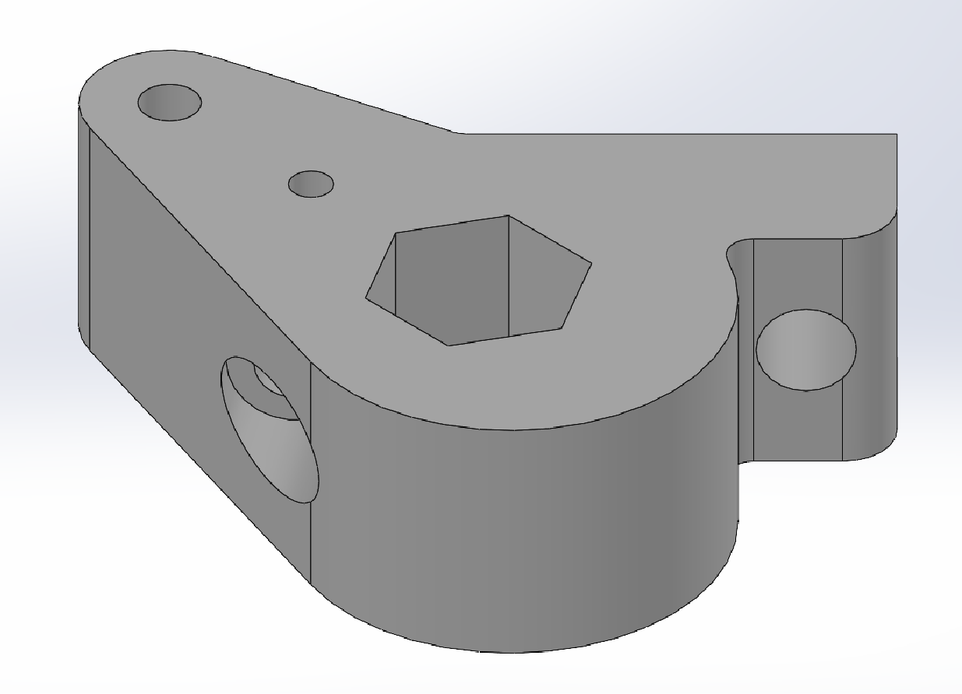
Nitinol Mount Assembly
To assemble the nitinol cable mounts, start with the bracket

Slide 41

Nitinol Mount Assembly
Push a ¼-20 thread hex nut into the center hexagonal hole until it reaches the bottom

Slide 42
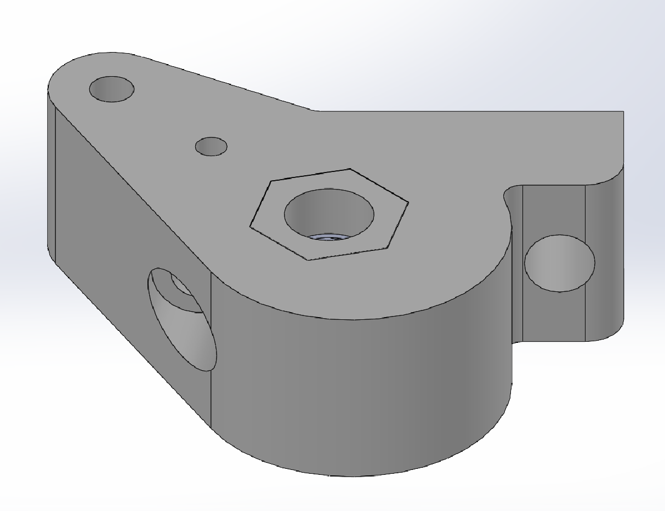
Nitinol Mount Assembly
Push the hex nut mount cap into the hole on top of the nut and use a soldering iron or similar heat application tool to melt and fuse the PLA around the edges of the cap to the bracket

Slide 43
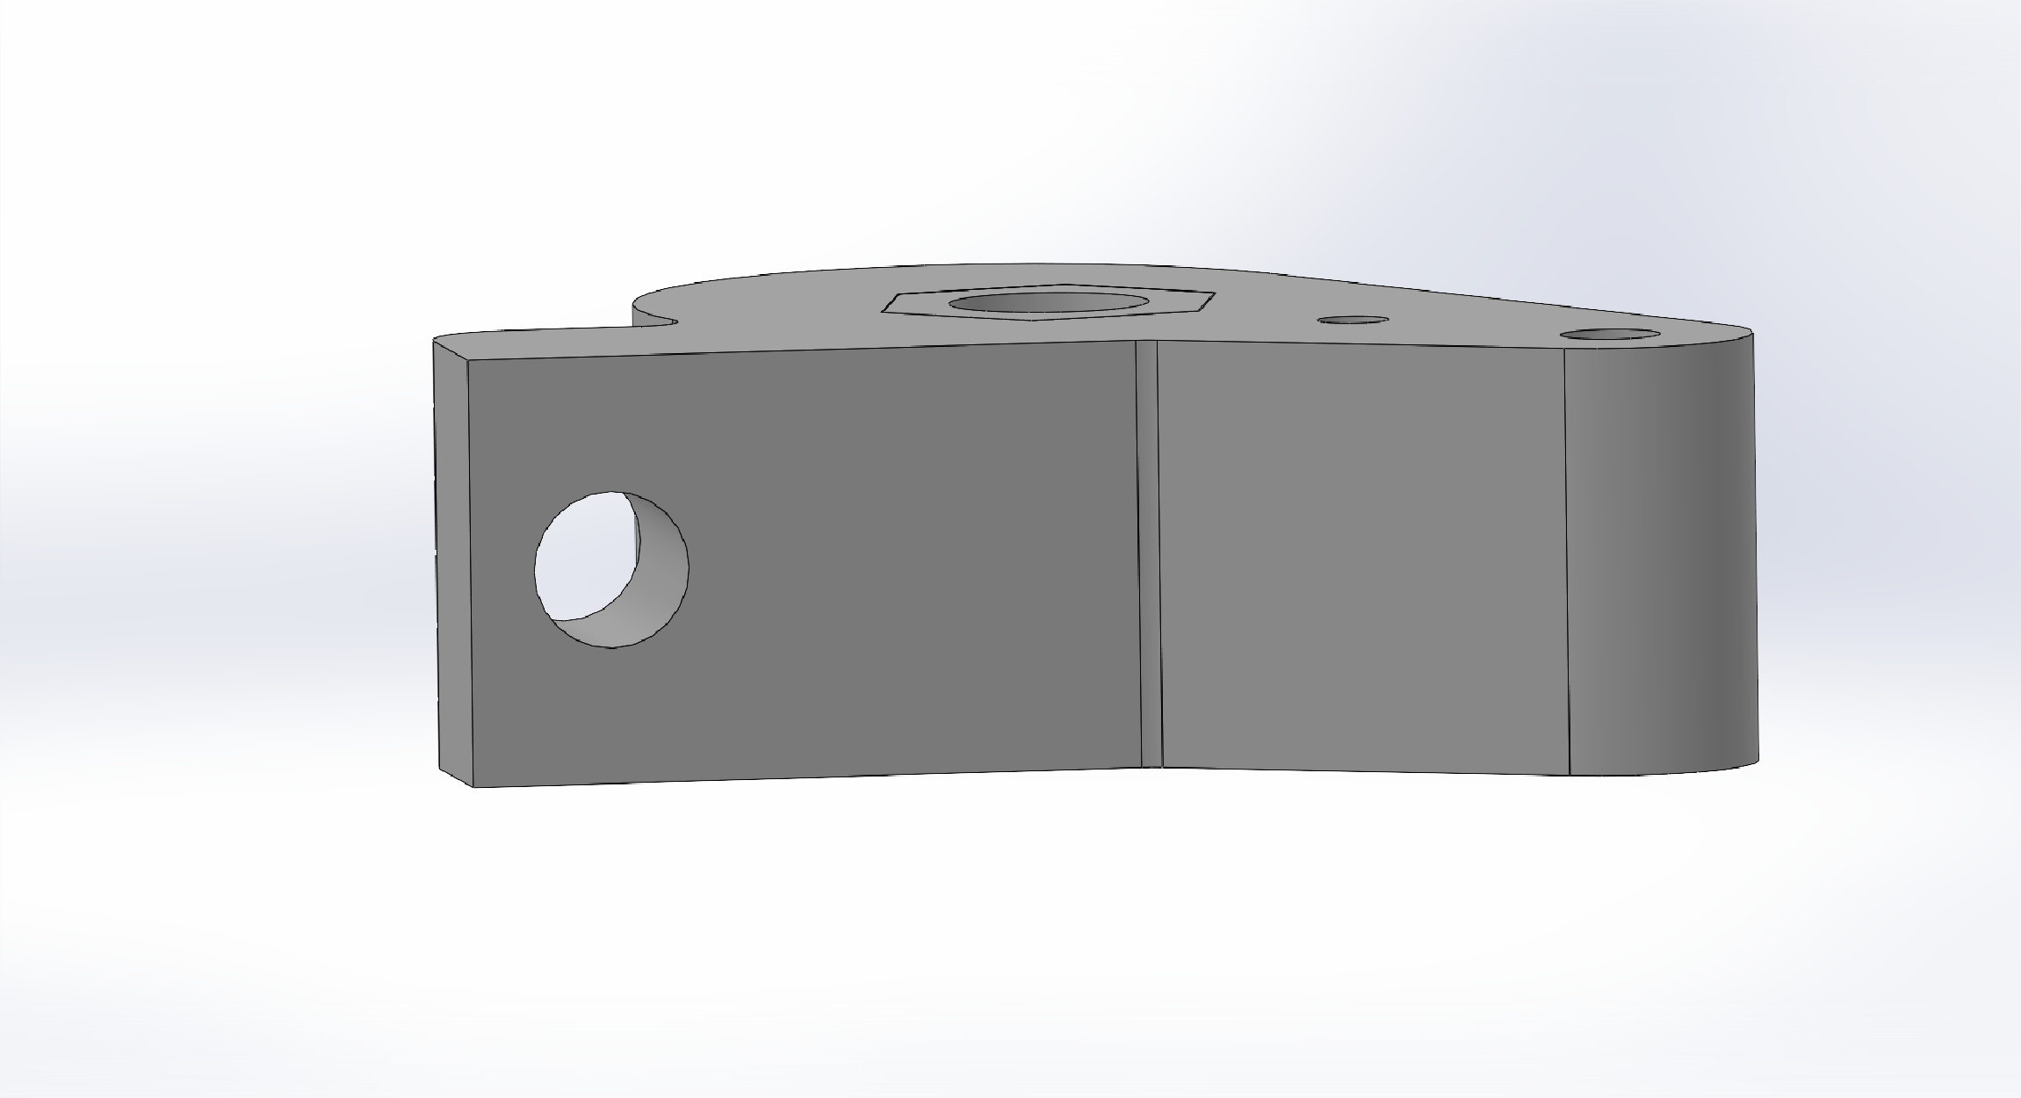
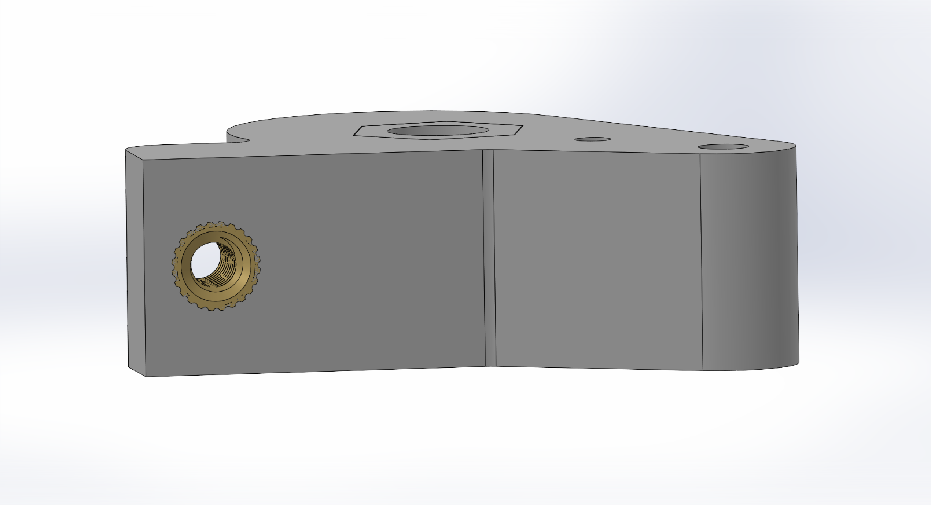
Nitinol Mount Assembly
Inserting from the larger flat side of the hole, insert a M4 8.2mm heat set insert until it is flush with the brakcet

Slide 44
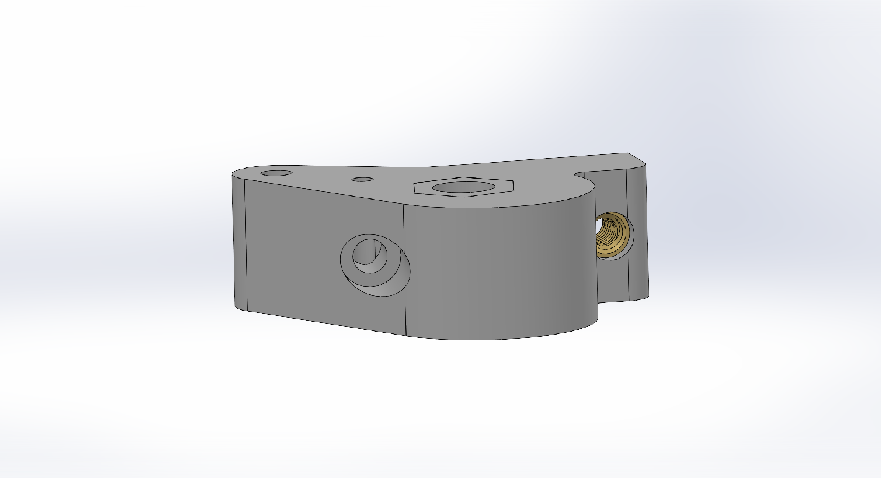
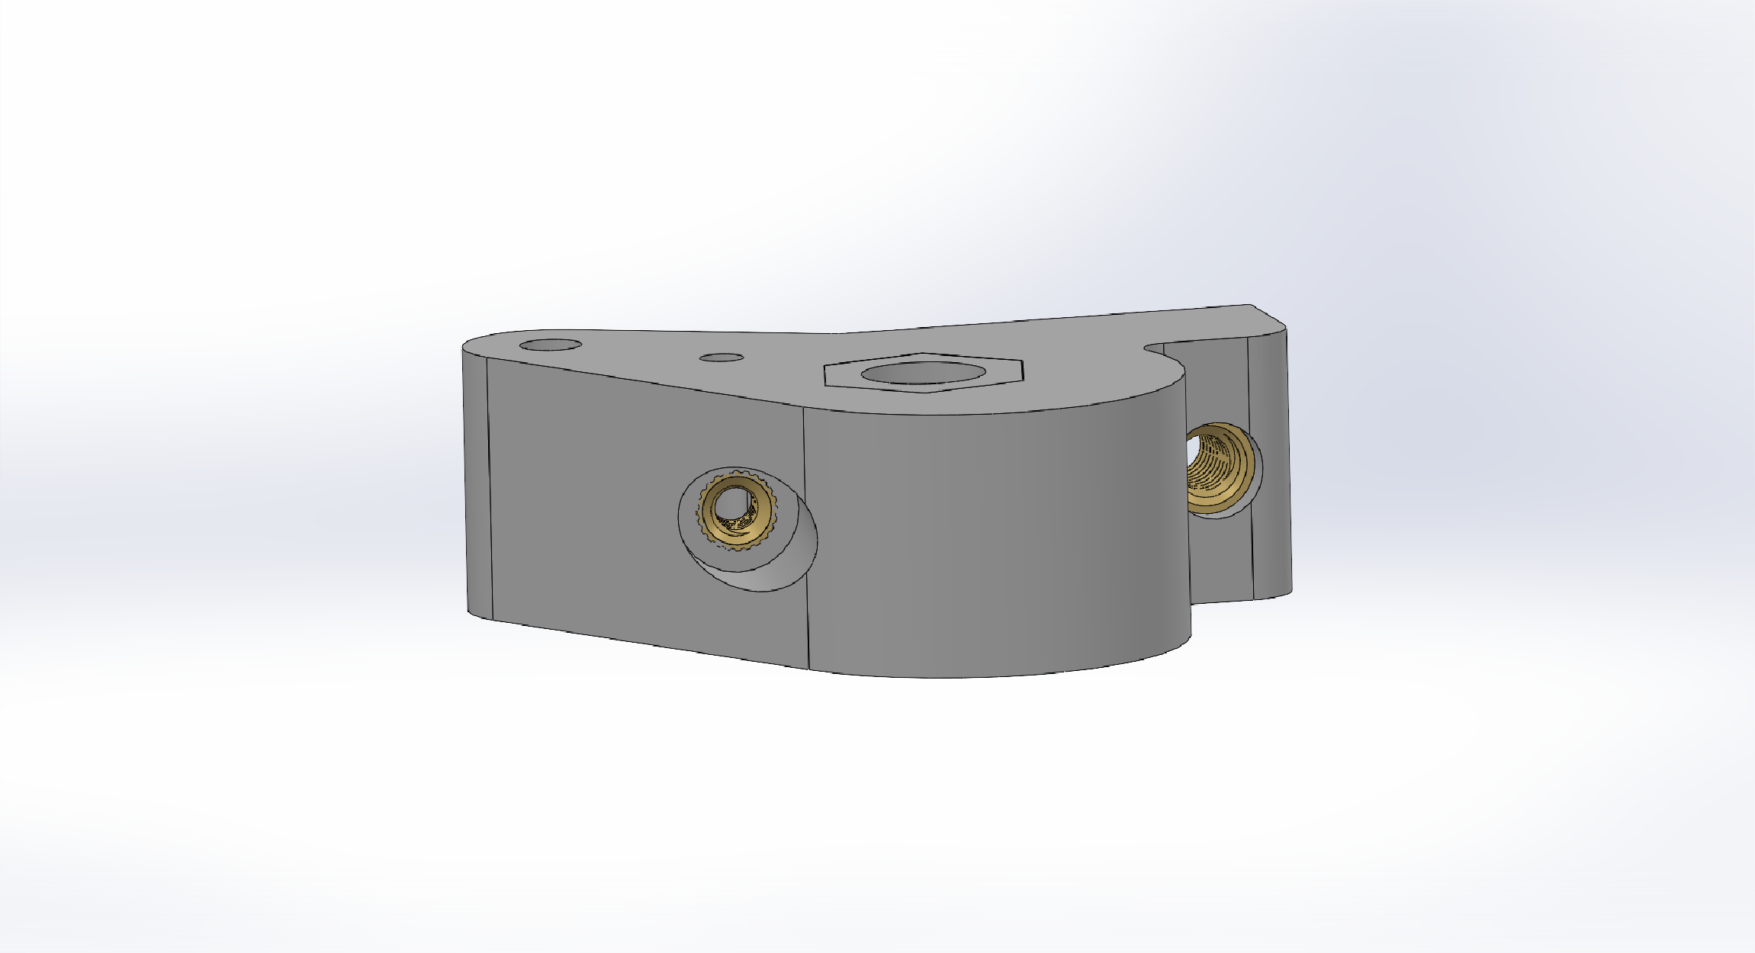
Nitinol Mount Assembly
Insert a M3 4.3mm heat set insert into hole located towards the center of the side of the bracket
Note: similar to the nitinol holes on the end link of the arm, it makes it easier to set the insert to the correct depth by feeding a nitinol rod through the top hole before inserting the heat set insert

Slide 45
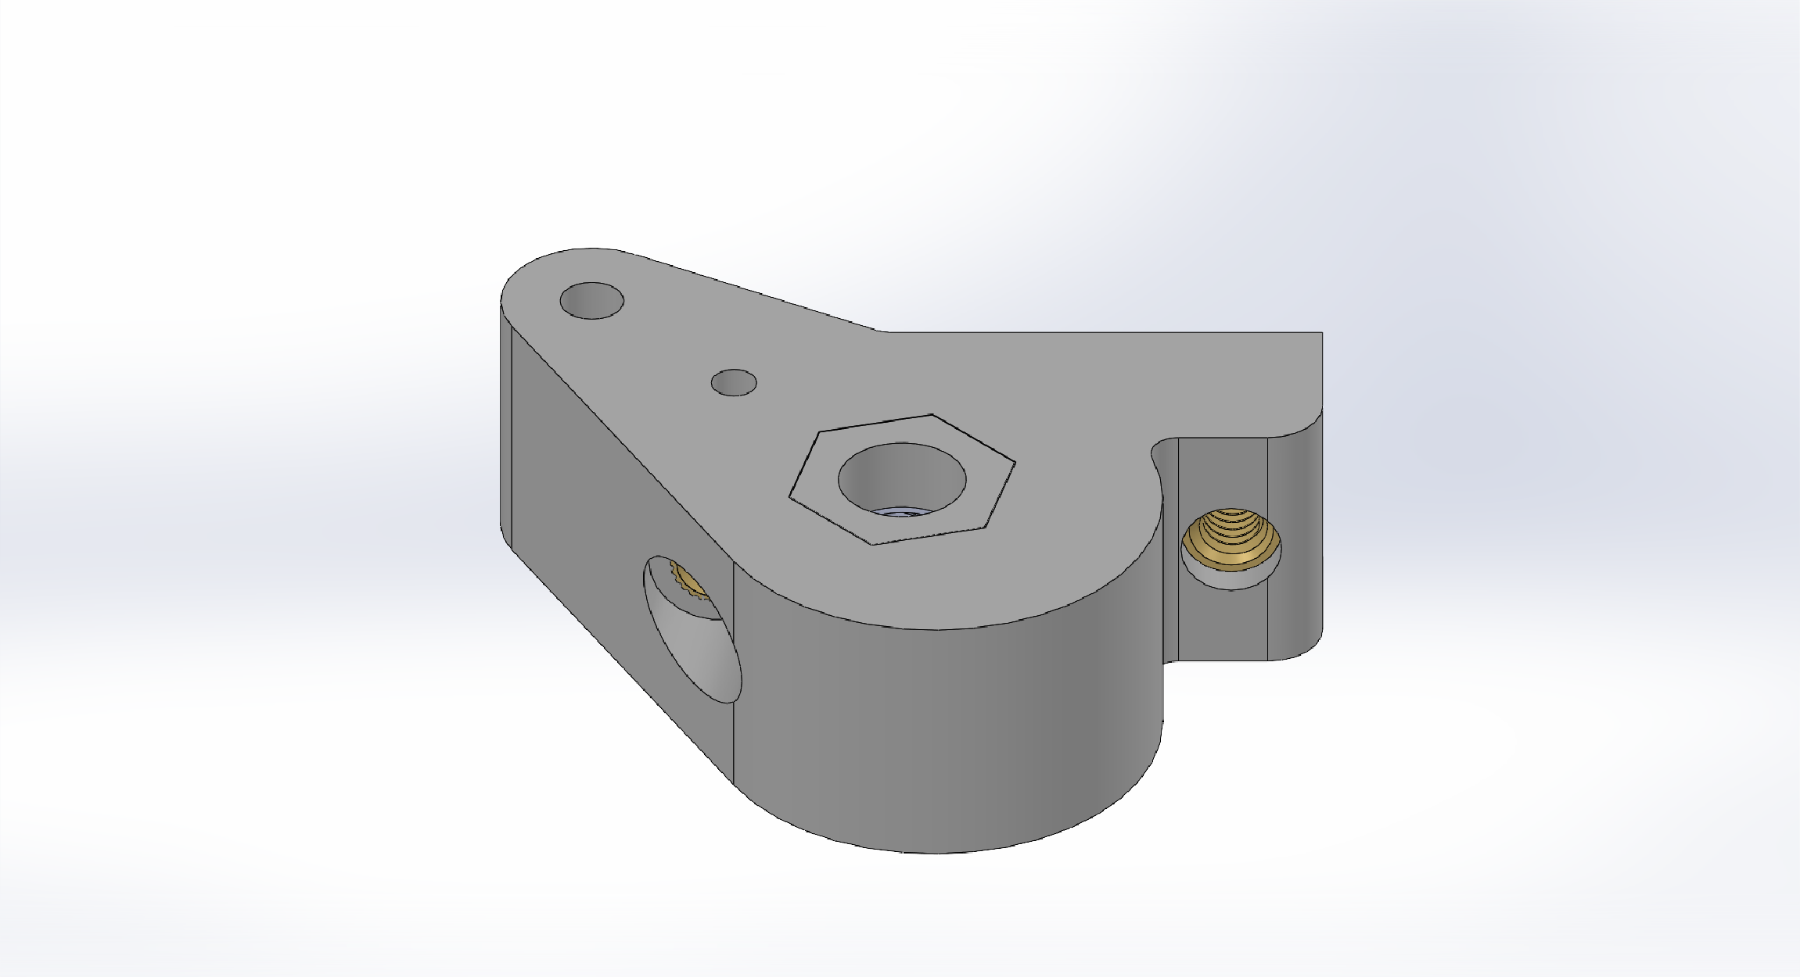
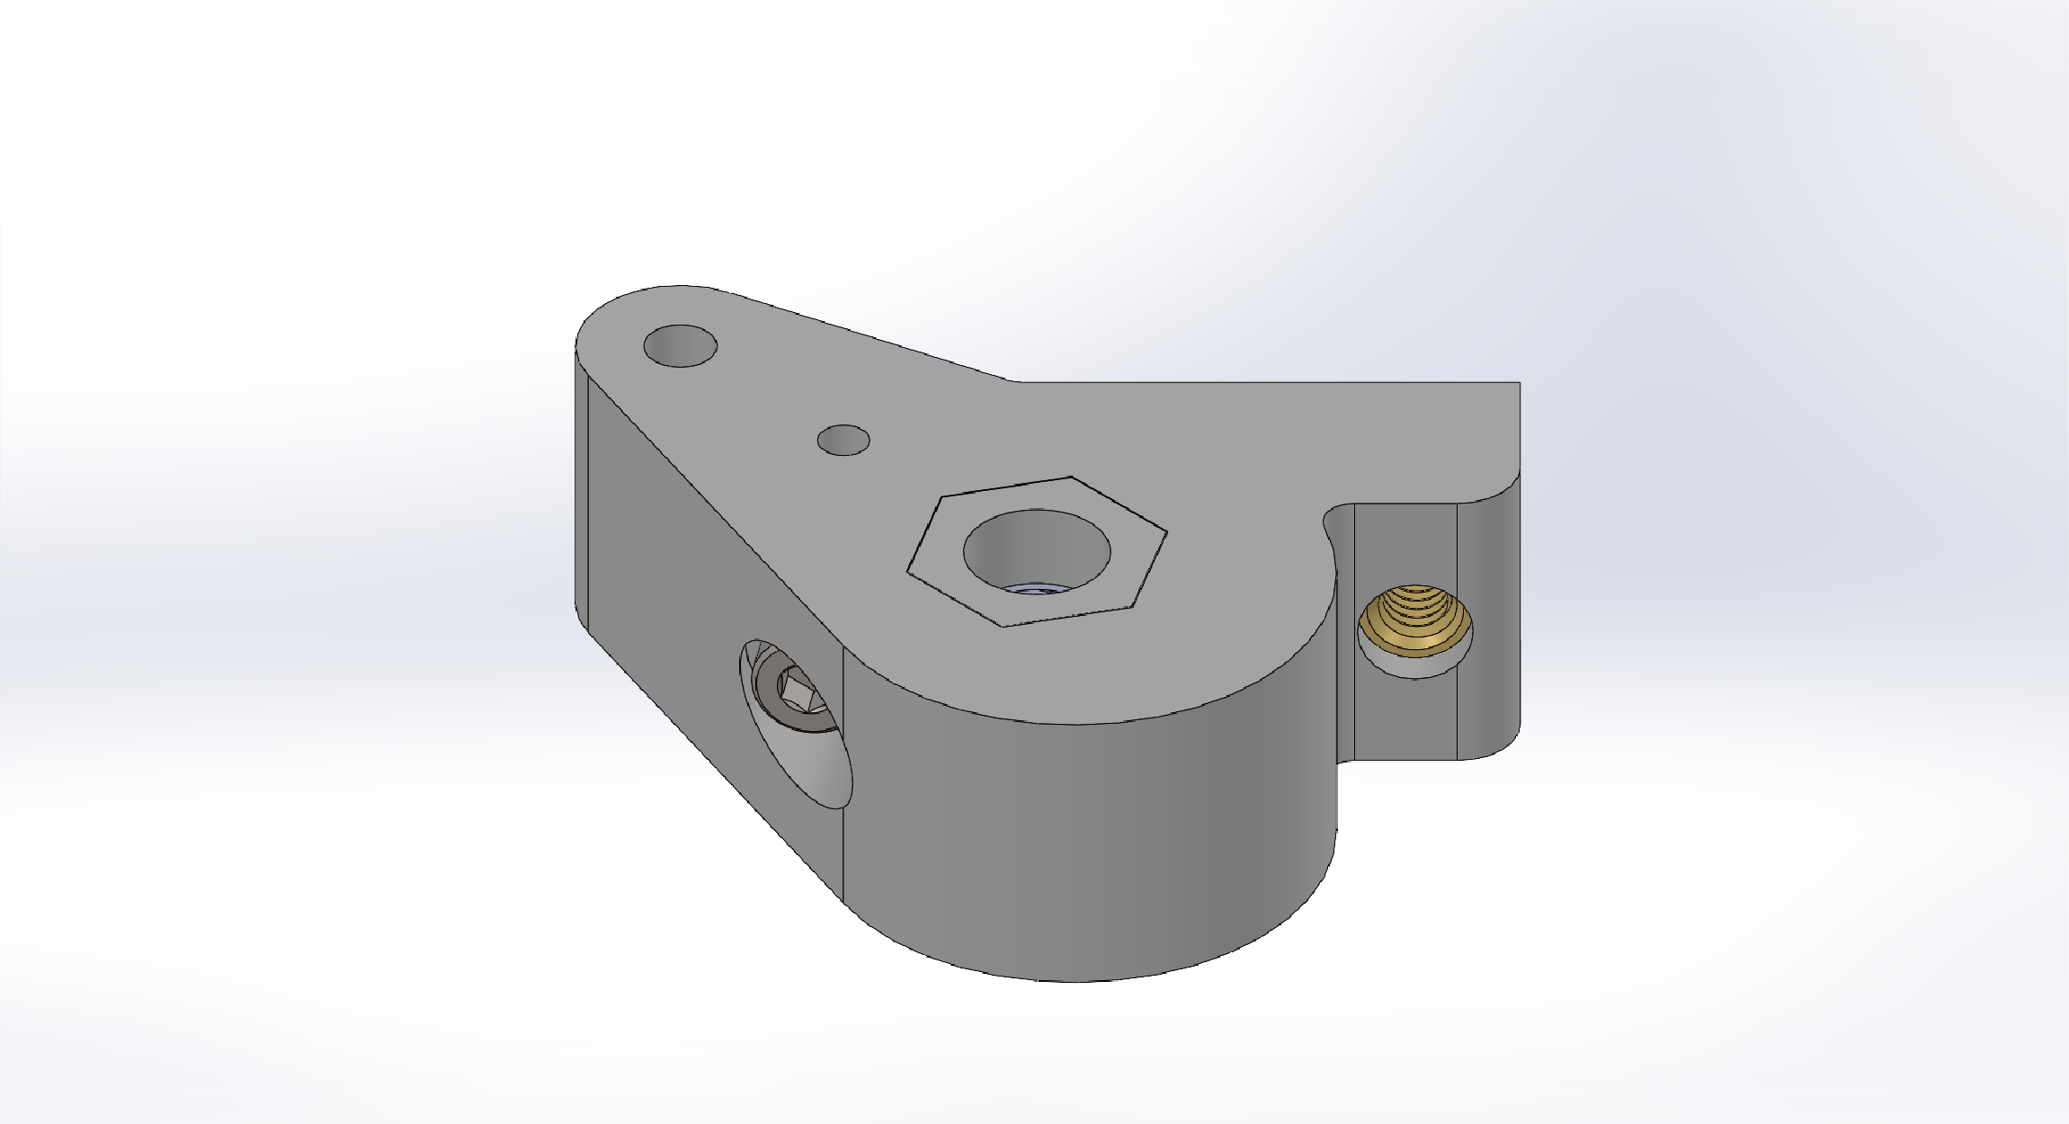
Nitinol Mount Assembly
Thread a M3x0.5 8mm screw into the heat set insert to help lock the nitinol when positioned in the actuator

Slide 46
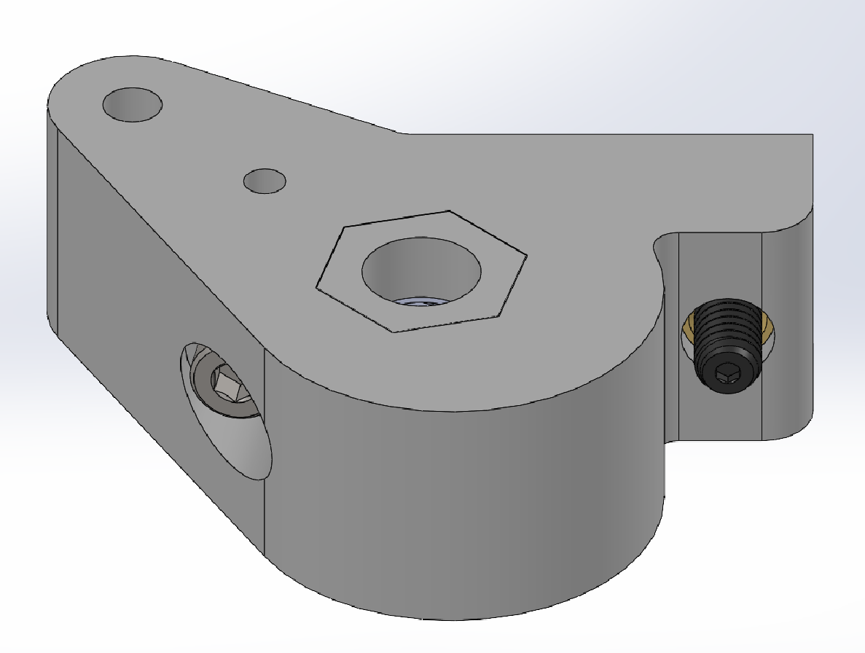
Nitinol Mount Assembly
Thread a M4x0.7 long nose spring plunger screw into the side heat set insert that will actuate the potentiometer in the final actuator

Slide 47
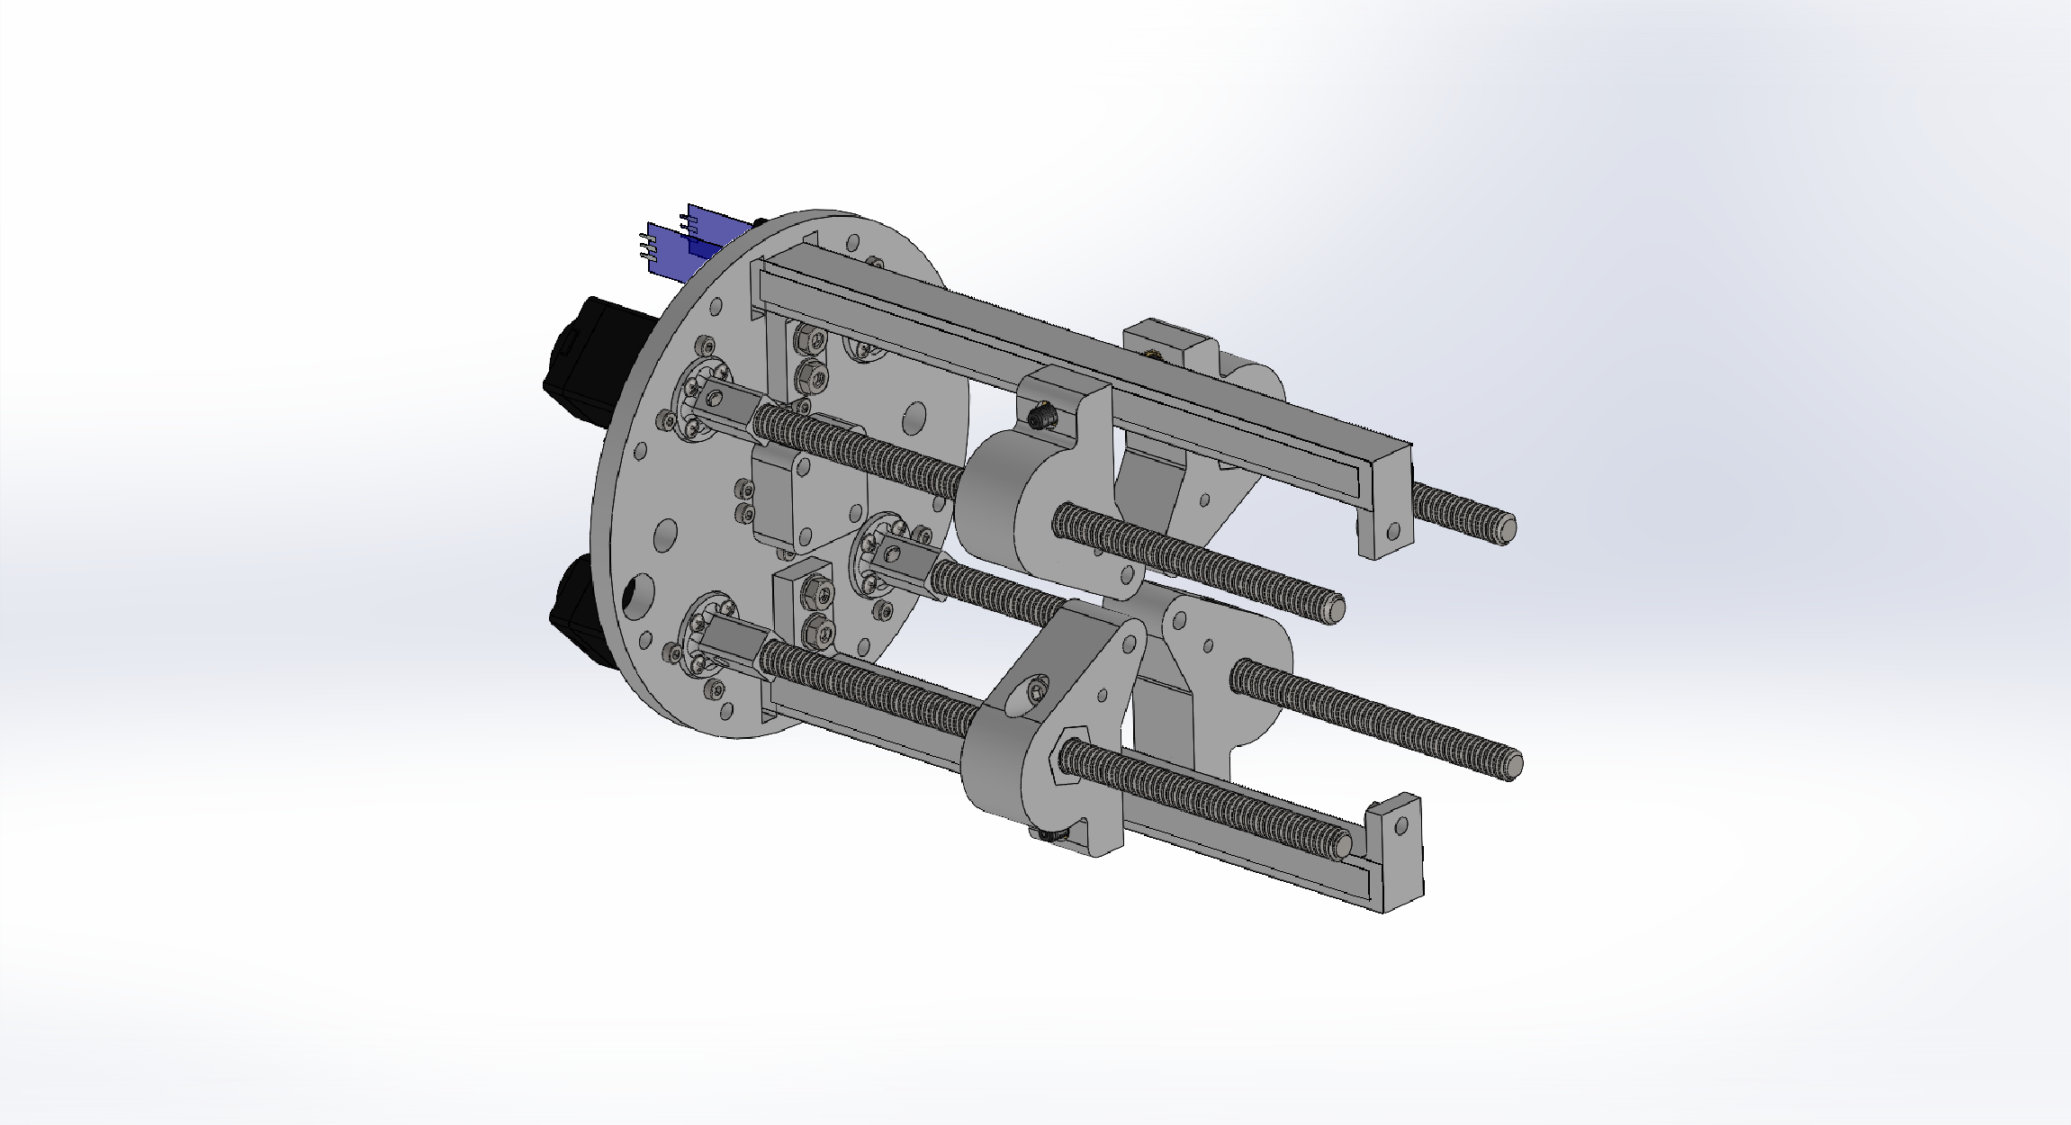
Actuator Assembly
Thread the nitinol mounts onto each threaded rod, it may be easier to rotate the threaded rod to position the mounts
Note: the exact position of each mount does not explicitly matter at this point as the homing program can move them to the final position after the finished assembly

Slide 48
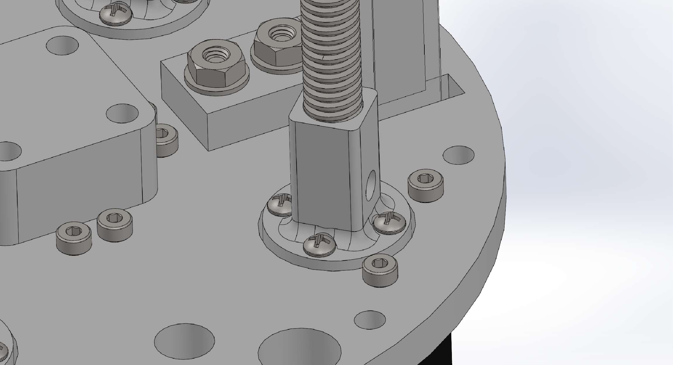
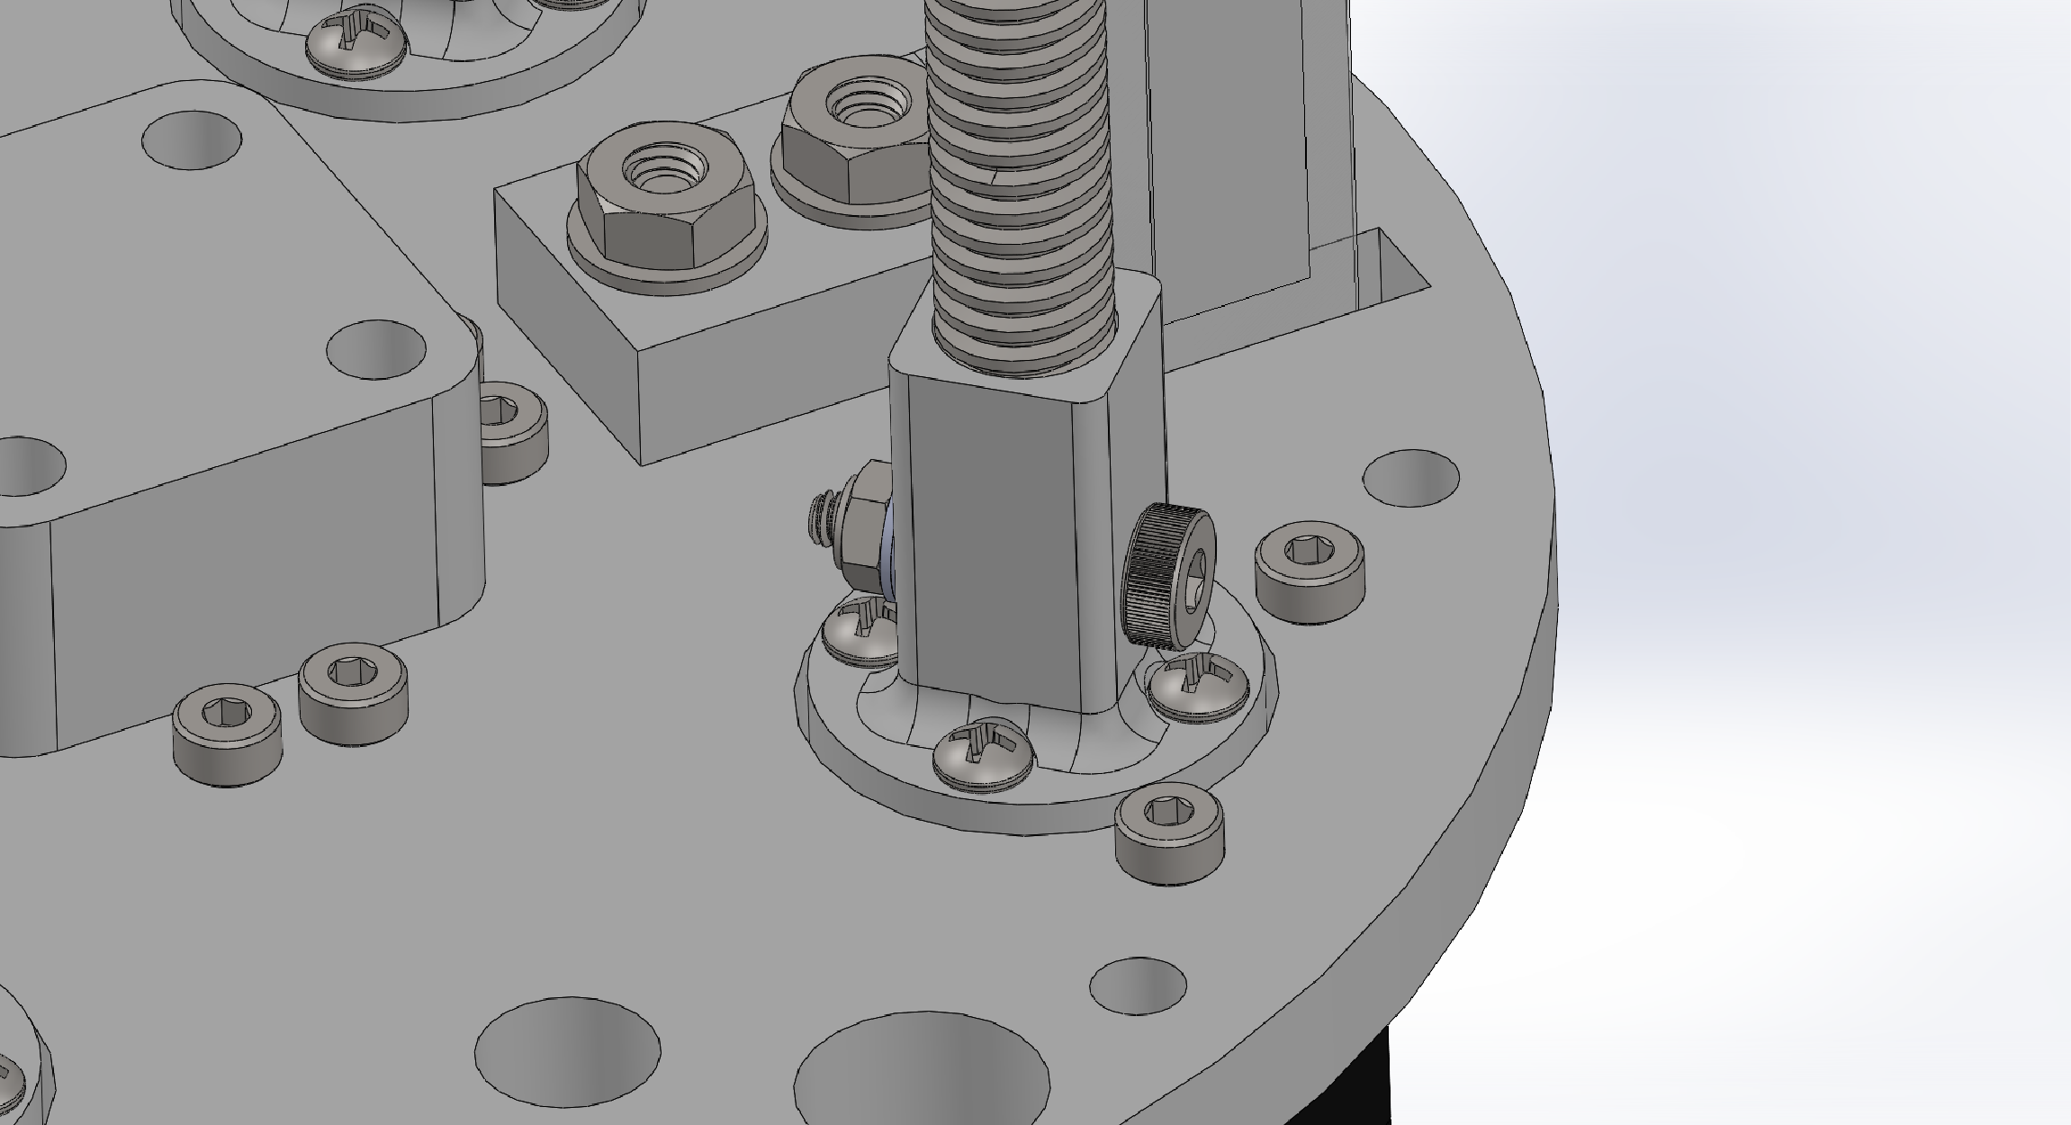
Actuator Assembly
Insert a 3mm x 8mm M2 shoulder screw through the side hole on the mount
Thread on two M2 size washers and a M2 nut to secure the screw and threaded rod

Slide 49
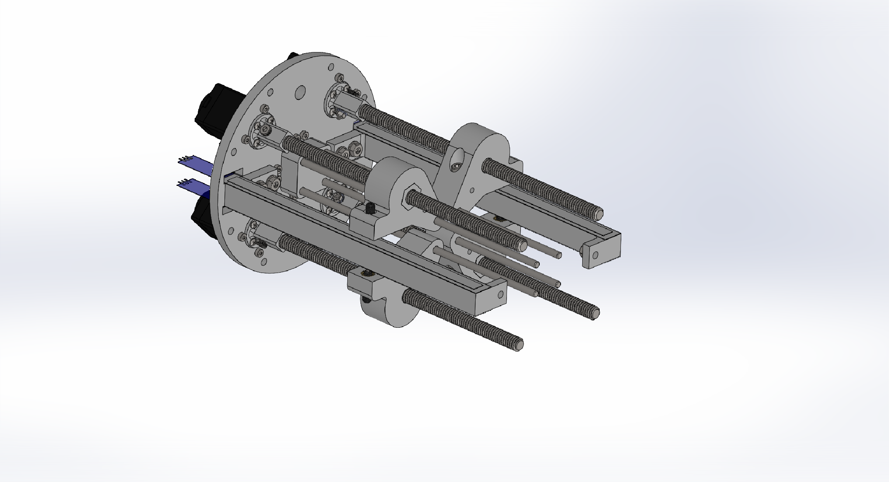
Actuator Assembly
Insert linear motion shafts through the end hole of each nitinol mount and into the corresponding base hole

Slide 50
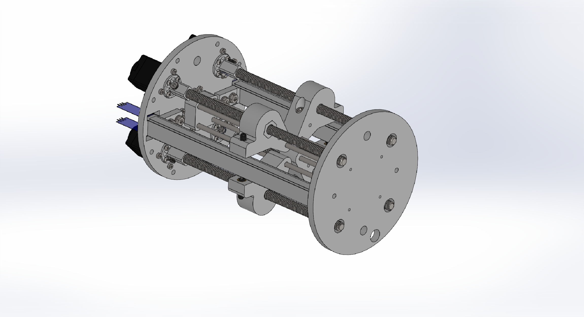
Actuator Assembly
Position actuator top with using the linear shaft holes and threaded rod holes as a guide
Note: Make sure the proper mounting screw holes are lined up with the potentiometer mounts

Slide 51

Actuator Assembly
Insert nylon sleeve bearings into each threaded rod hole to secure translational movement of the threaded rods

Slide 52

Actuator Assembly
Attach ¼-20 threaded 6 in long aluminum standoffs to the sides of the actuator for stability and strength of the system.
Fasten the bottom of the standoffs to the base using ¼-20 thread 1 in long screws

Slide 53

Actuator Assembly
When mounting the aluminum standoffs, use the mounting screws to also fasten the electronics mounting plate to the base plate
Position enclosure mounts to the base plate holes for mounting
Note: Not pictured, it is best to mount circuits to the electronics mounting plate before assembly

Slide 54

Actuator Assembly
Using M3x0.5 16mm screws threaded through the base plate and M3 nuts on to secure the fastener, attach the enclosure mounts to the base of the actuator

Slide 55

Actuator Assembly
Mount the enclosure my first screwing the enclosure mounts to the bottom O-Ring flange and then insert system into the tube

Slide 56

Full Assembly
Start with the actuation unit assembly

Slide 57

Full Assembly
Lining up the mounting holes of the base of the arm and the top of the actuation unit, thread the nitinol cables through the center holes until the arm base and the actuation unit are touching
Note: Make sure to also thread the nitinol cables into the nitinol mounts in the center of the actuation unit

Slide 58

Full Assembly
Through the base of the arm to the aluminum standoffs, thread a 1 in long ¼-20 screw to fasten the arm to the actuation unit

Slide 59

Full Assembly
Thread M3x0.5 20mm screw into the remaining two mounting holes on the base of the arm
Use an M3 nut and washer to secure the screws on the underside of the top of the actuation unit

Slide 60

Full Assembly
With the arm and actuation unit assembled, the waterproof enclosure and bellows can be fitted onto the arm to complete the seal
The enclosure should be fitted first with the bellows fit over the arm to seal with the enclosure

